Slide 1
Chapter 17 Exception Handling: A Deeper Look
C++ How to Program, 9/e

Slide 2
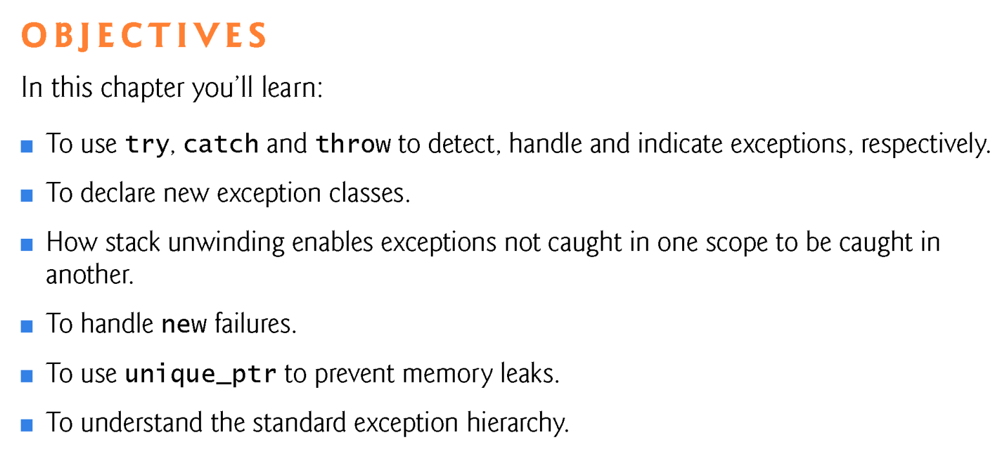

Slide 3
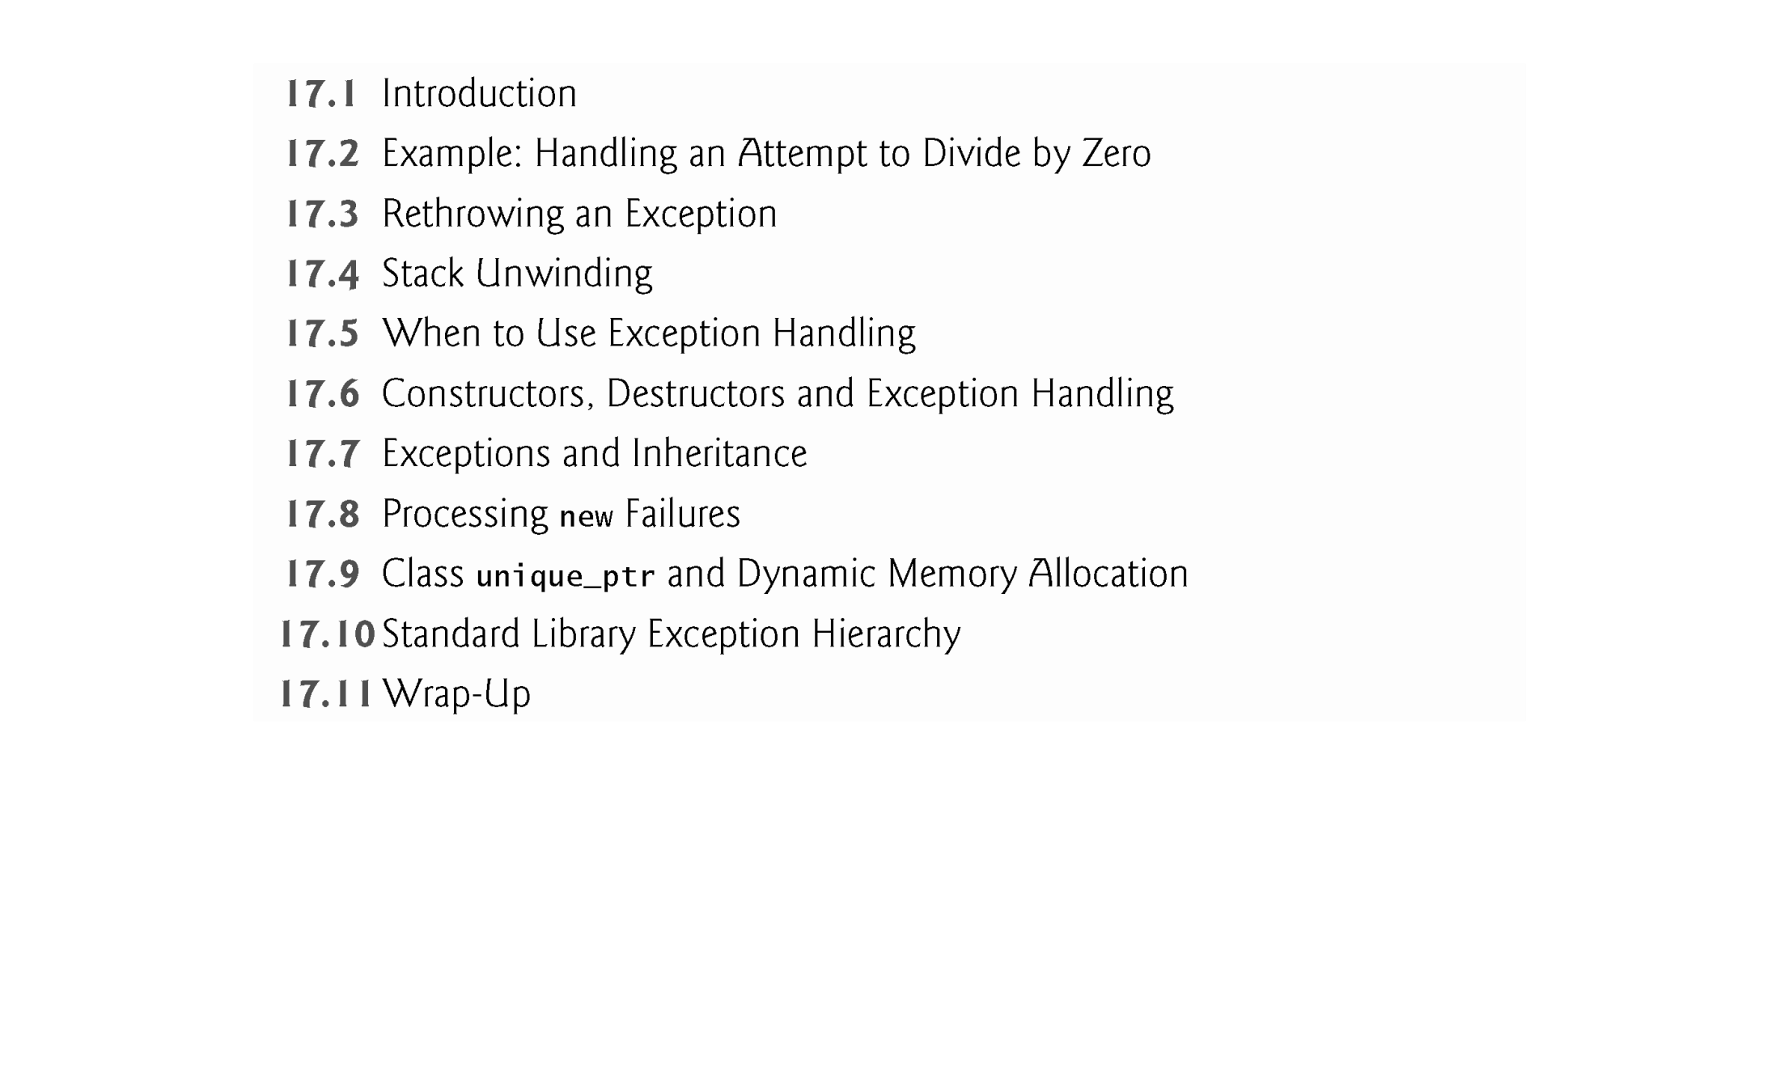

Slide 4
17.1 Introduction
An exception is an indication of a problem that occurs during a program’s execution.
Exception handling enables you to create applications that can resolve (or handle) exceptions.
In many cases, this allows a program to continue executing as if no problem had been encountered.
The features presented in this chapter enable you to write robust and fault-tolerant programs that can deal with problems that may arise and continue executing or terminate gracefully.

Slide 5
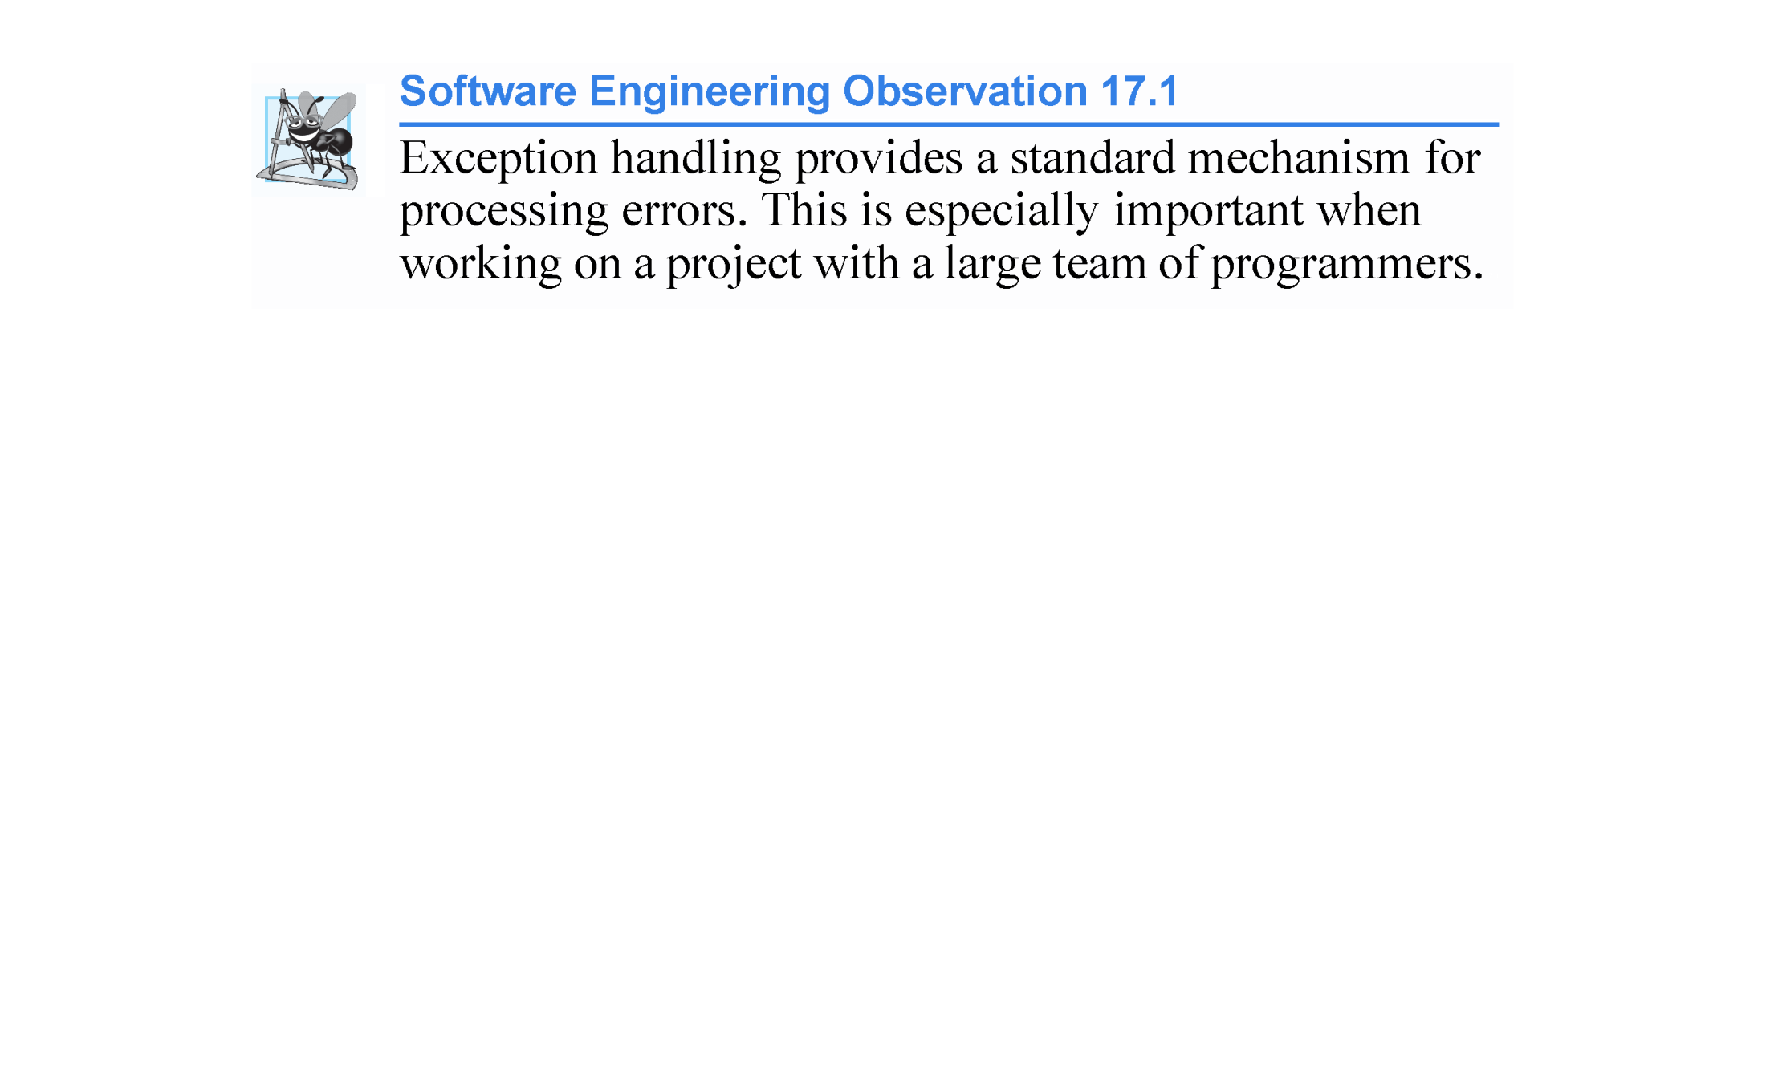

Slide 6
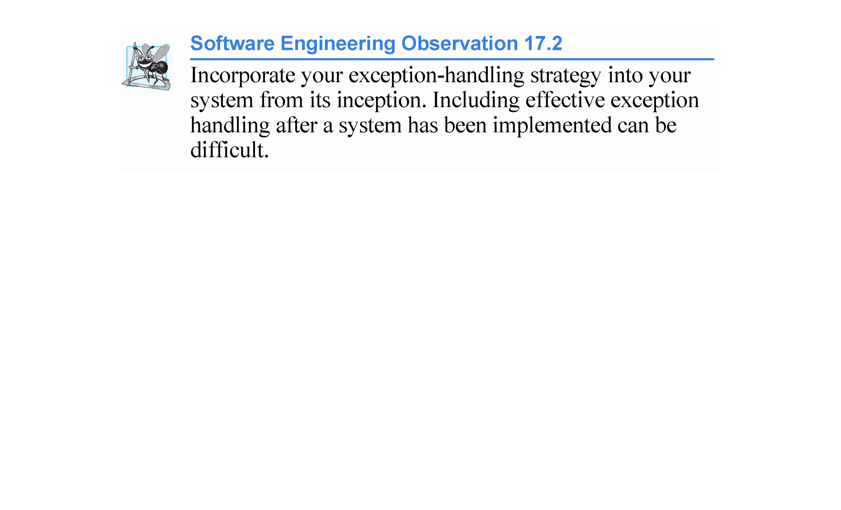

Slide 7
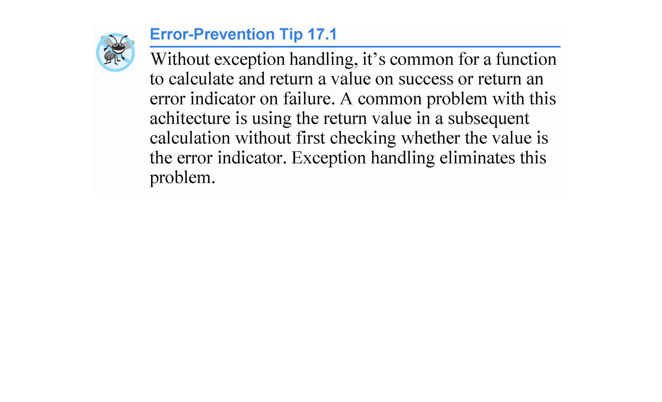

Slide 8
17.2 Example: Handling an Attempt to Divide by Zero
Let’s consider a simple example of exception handling (Figs. 17.1–17.2).
We show how to deal with a common arithmetic problem—division by zero.
Division by zero using integer arithmetic typically causes a program to terminate prematurely.
In floating-point arithmetic, many C++ implementations allow division by zero, in which case positive or negative infinity is displayed as INF or -INF, respectively.

Slide 9
17.2 Example: Attempt to Divide by Zero (cont.)
In this example, we define a function named quotient that receives two integers input by the user and divides its first int parameter by its second int parameter.
Before performing the division, the function casts the first int parameter’s value to type double.
Then, the second int parameter’s value is promoted to type double for the calculation.
So function quotient actually performs the division using two double values and returns a double result.

Slide 10
17.2 Example: Attempt to Divide by Zero (cont.)
Although division by zero is allowed in floating-point arithmetic, for the purpose of this example we treat any attempt to divide by zero as an error.
Thus, function quotient tests its second parameter to ensure that it isn’t zero before allowing the division to proceed.
If the second parameter is zero, the function uses an exception to indicate to the caller that a problem occurred.
The caller (main in this example) can then process the exception and allow the user to type two new values before calling function quotient again.
In this way, the program can continue to execute even after an improper value is entered, thus making the program more robust.

Slide 11
17.2 Example: Attempt to Divide by Zero (cont.)
DivideByZeroException.h (Fig. 17.1) defines an exception class that represents the type of the problem that might occur in the example, and fig17_02.cpp (Fig. 17.2) defines the quotient function and the main function that calls it.
Function main contains the code that demonstrates exception handling.

Slide 12
17.2 Example: Attempt to Divide by Zero (cont.)
Defining an Exception Class to Represent the Type of Problem That Might Occur
Figure 17.1 defines class DivideByZeroException as a derived class of Standard Library class runtime_error (from header file <stdexcept>).
Class runtime_error - a derived class of exception (from header file <exception>) - is the C++ standard base class for representing runtime errors.
Class exception is the standard C++ base class for exception classes in the C++ Standard Library.
Section 17.10 discusses class exception and its derived classes in detail.

Slide 13
17.2 Example: Attempt to Divide by Zero (cont.)
A typical exception class that derives from the runtime_error class defines only a constructor (e.g., lines 11–12) that passes an error-message string to the base-class runtime_error constructor.
Every exception class that derives directly or indirectly from exception contains the virtual function what, which returns an exception object’s error message.
You are not required to derive a custom exception class, such as DivideByZeroException, from the standard exception classes provided by C++.
Doing so allows you to use the virtual function what to obtain an appropriate error message.
We use an object of this DivideByZeroException class in Fig. 17.2 to indicate when an attempt is made to divide by zero.

Slide 14
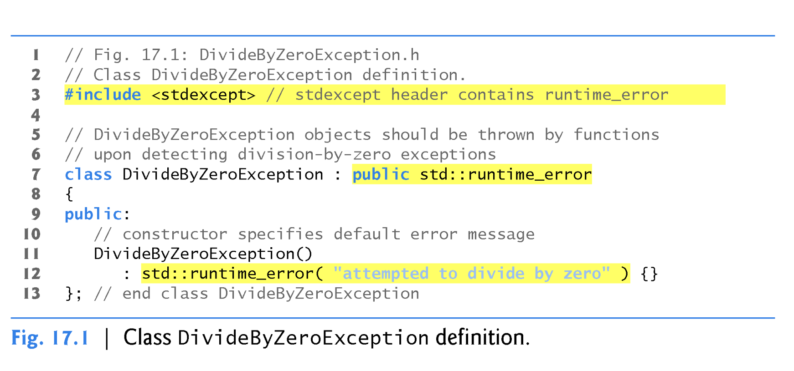
public inheritance from base class runtime_error
call base class constructor runtime_error and provide the string displayed by the what() function.
class derived class : <optional access specifier> base class
class DivideByZeroException : public std::runtime_error

Slide 15
17.2 Example: Attempt to Divide by Zero (cont.)
Demonstrating Exception Handling
Fig. 17.2 uses exception handling to wrap code that might throw a DivideByZeroException and to handle that exception, should one occur.
Function quotient divides its first parameter (numerator) by its second parameter (denominator).
Assuming that the user does not specify 0 as the denominator for the division, quotient returns the division result.
However, if the user inputs 0 for the denominator, function quotient throws an exception.

Slide 16
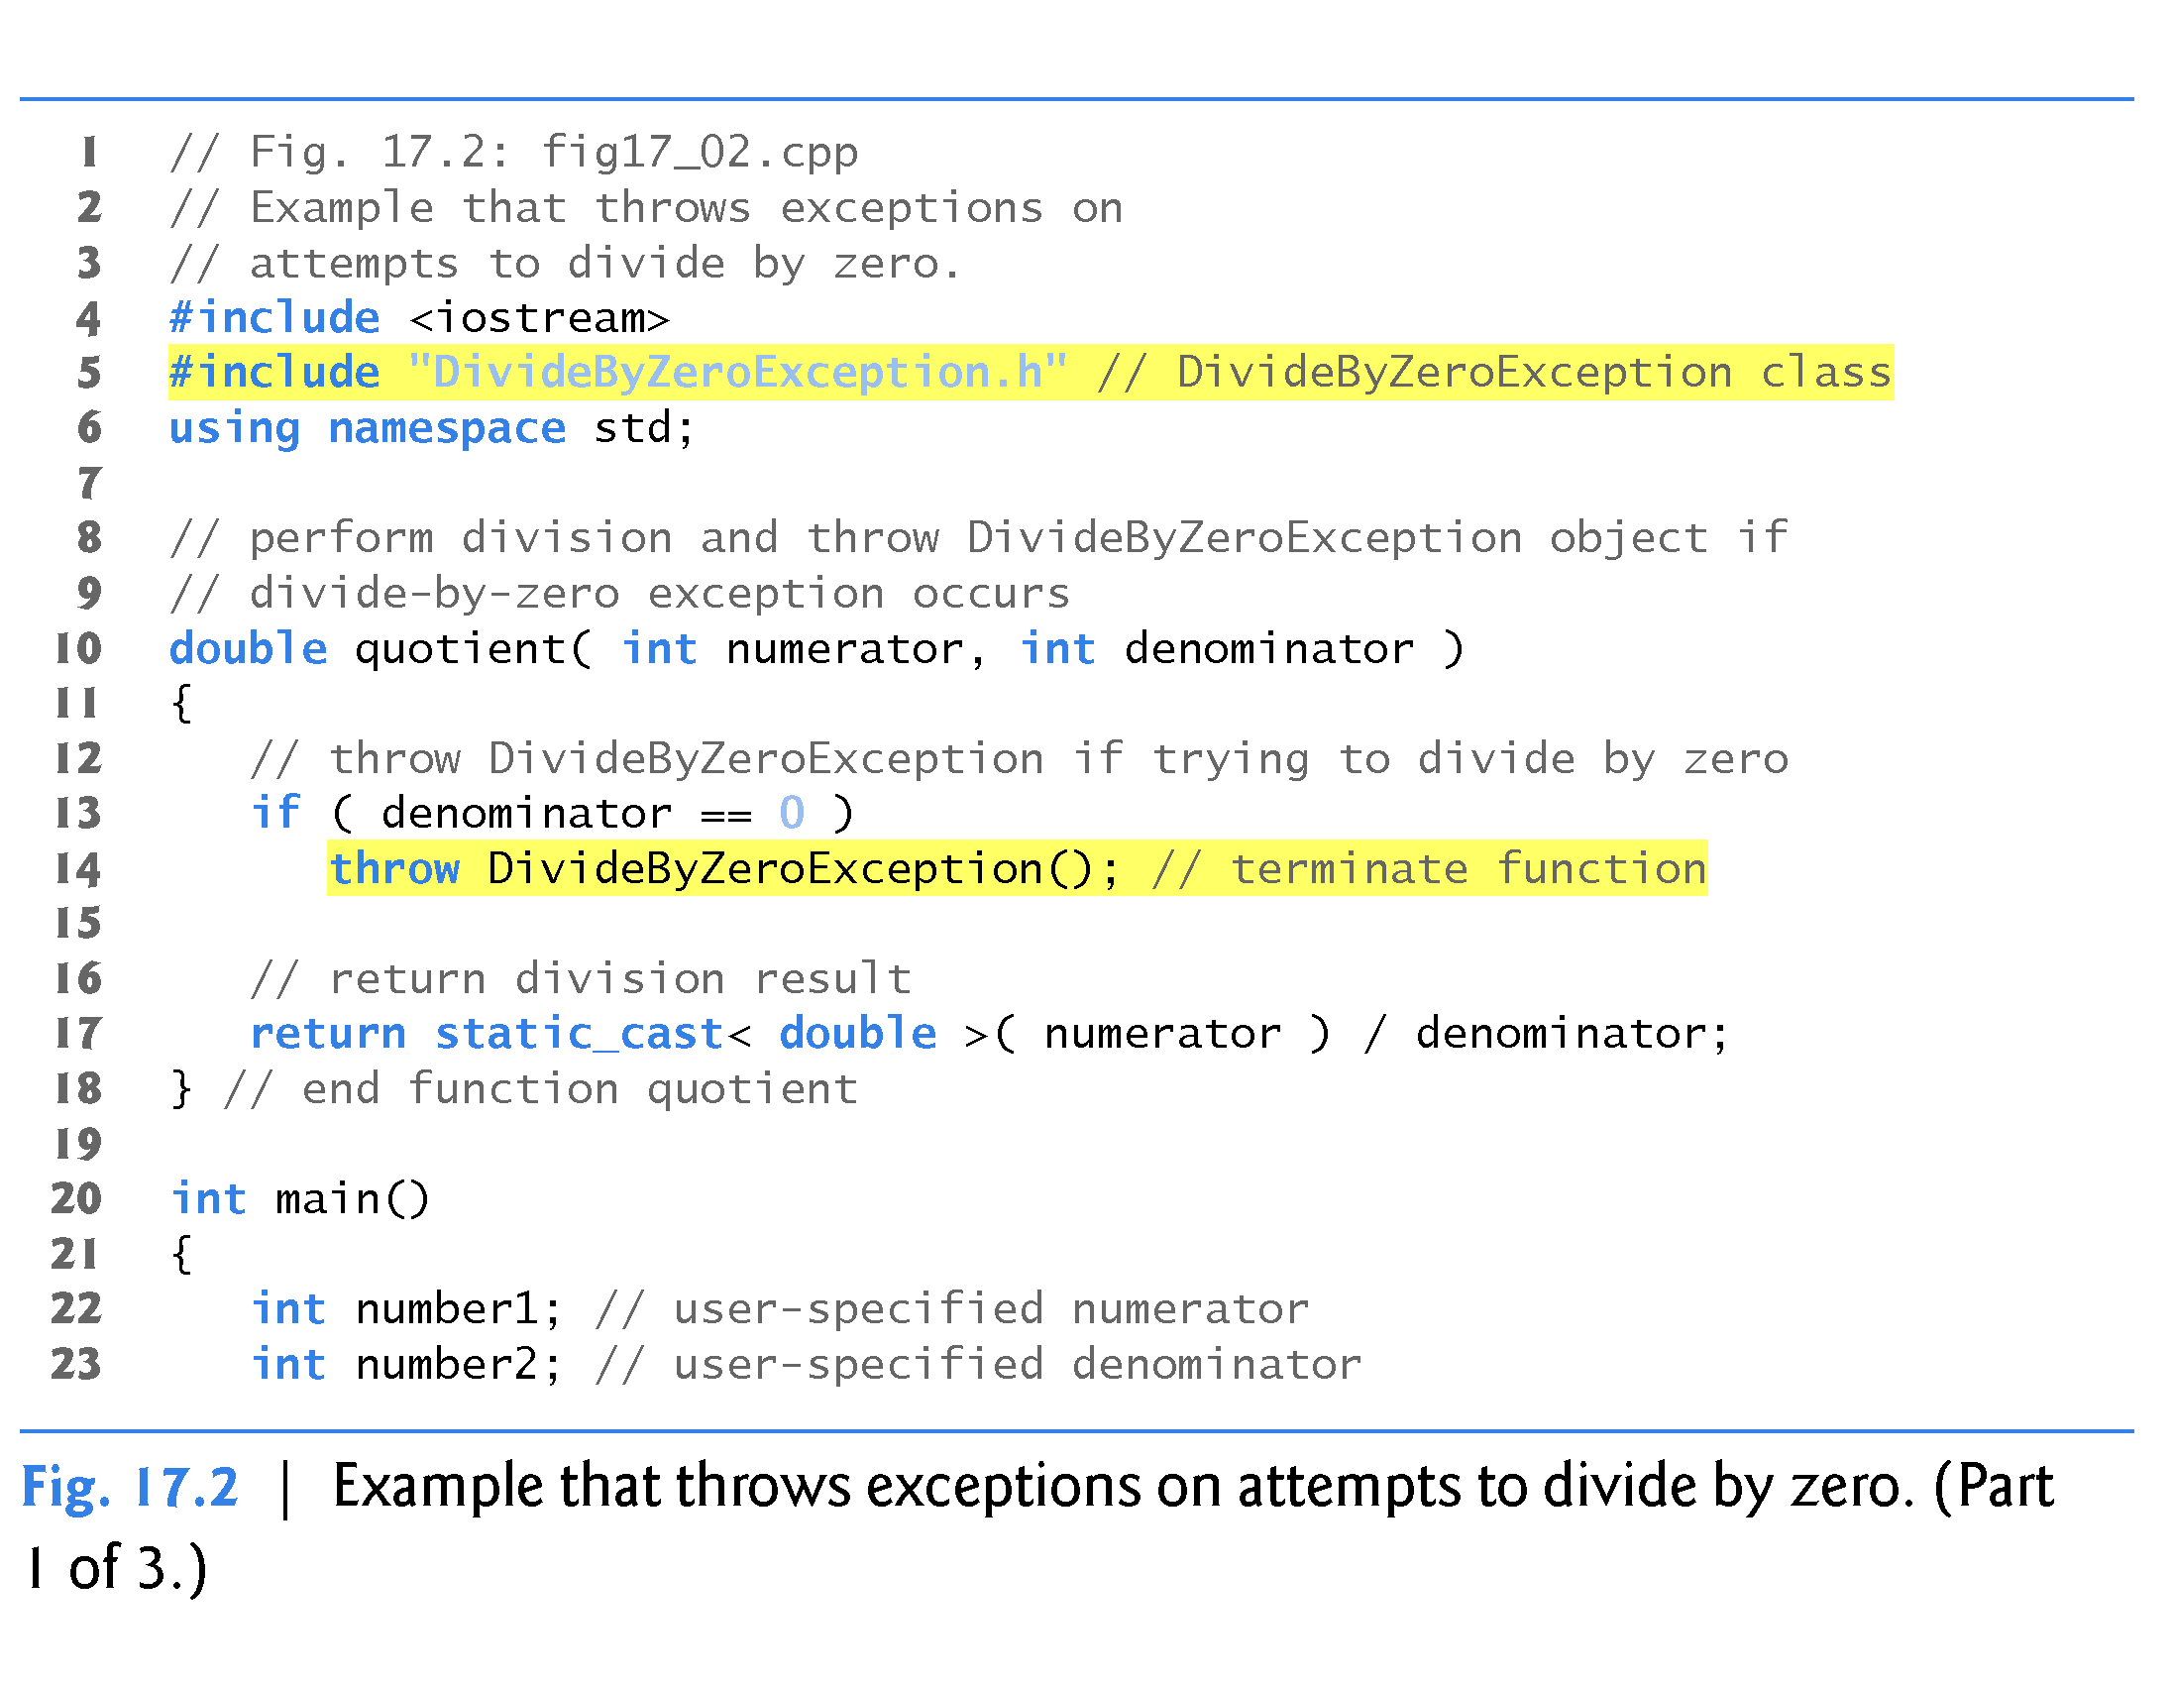
Notice it is:
if (denominator == 0 )
throw DivideByZeroException( );
with parentheses!
However, if the statements are separated:
if (denominator == 0 )
{
DivideByZeroException dbze;
throw dbze;
}

Slide 17
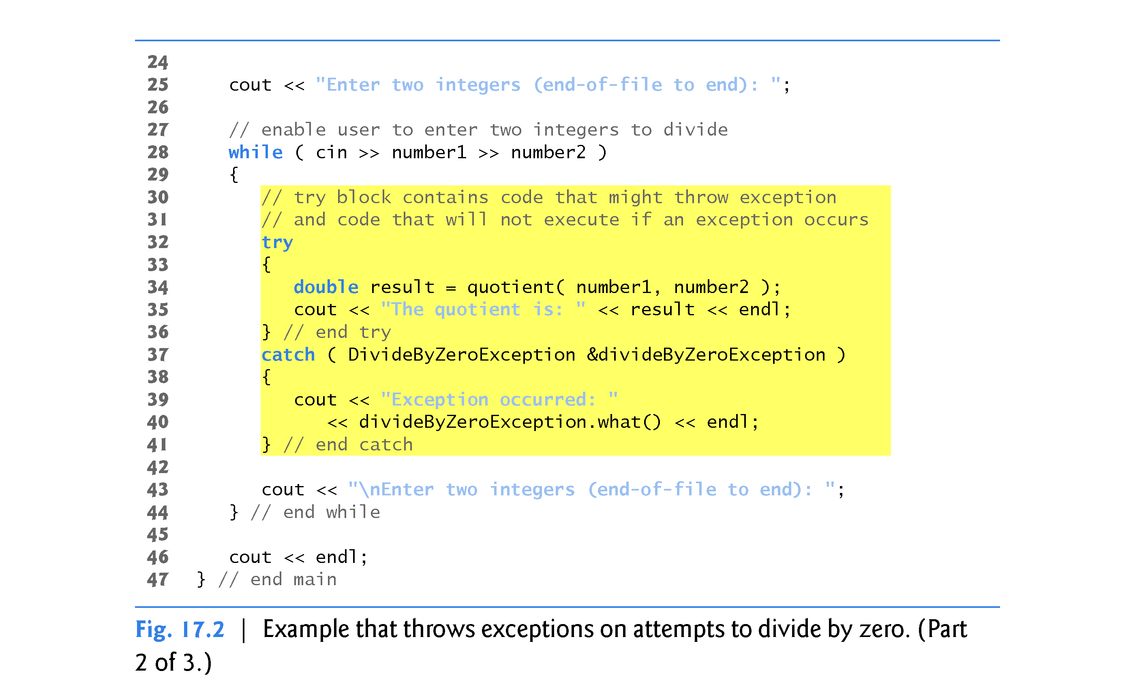

Slide 18
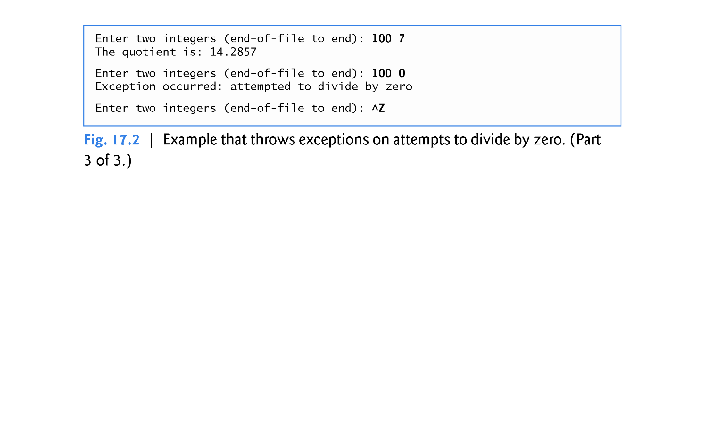

Slide 19
17.2 Example: Attempt to Divide by Zero (cont.)
Enclosing Code in a try Block
Exception handling is geared to situations in which the function that detects an error is unable to handle it.
try blocks enable exception handling.
The try block encloses statements that might cause exceptions and statements that should be skipped if an exception occurs.
In this example, because the invocation of function quotient (line 34) can throw an exception, we enclose this function invocation in a try block.
Enclosing the output statement (line 35) in the try block ensures that the output will occur only if function quotient returns a result.

Slide 20
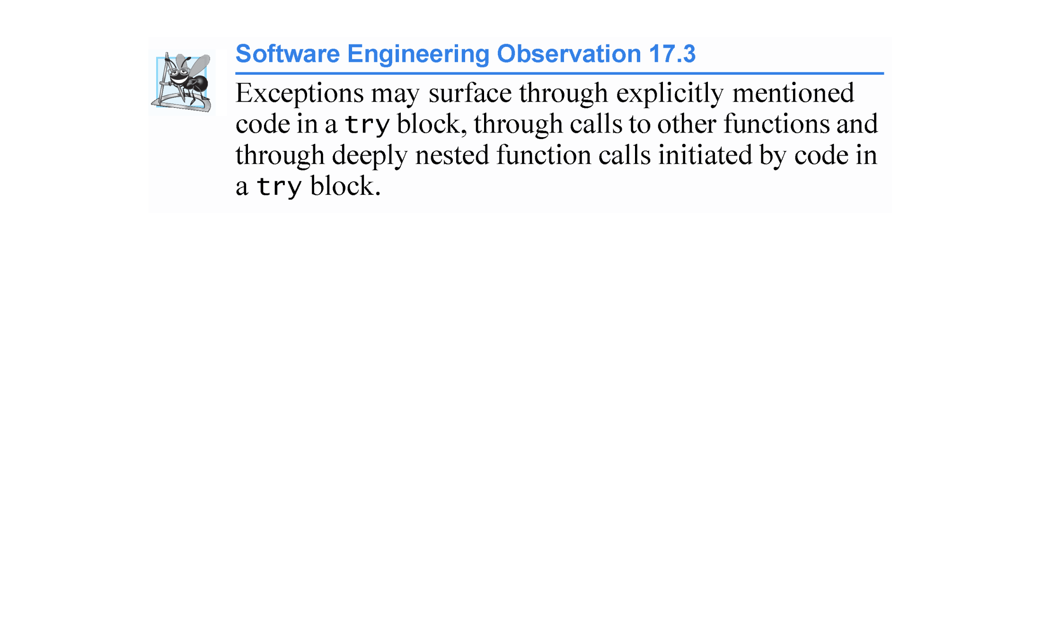

Slide 21
17.2 Example: Attempt to Divide by Zero (cont.)
Defining a catch Handler to Process a DivideByZeroException
Exceptions are processed by catch handlers.
At least one catch handler (lines 37–41) must immediately follow each try block.
An exception parameter should always be declared as a reference to the type of exception the catch handler can process (DivideByZeroException in this case)—this prevents copying the exception object when it’s caught and allows a catch handler to properly catch derived-class exceptions as well.
When an exception occurs in a try block, the catch handler that executes is the first one whose type matches the type of the exception that occurred (i.e., the type in the catch block matches the thrown exception type exactly or is a direct or indirect base class of it).

Slide 22
17.2 Example: Attempt to Divide by Zero (cont.)
If an exception parameter includes an optional parameter name, the catch handler can use that parameter name to interact with the caught exception in the body of the catch handler, which is delimited by braces ({ and }).
A catch handler typically reports the error to the user, logs it to a file, terminates the program gracefully or tries an alternate strategy to accomplish the failed task.
In this example, the catch handler simply reports that the user attempted to divide by zero. Then the program prompts the user to enter two new integer values.

Slide 23
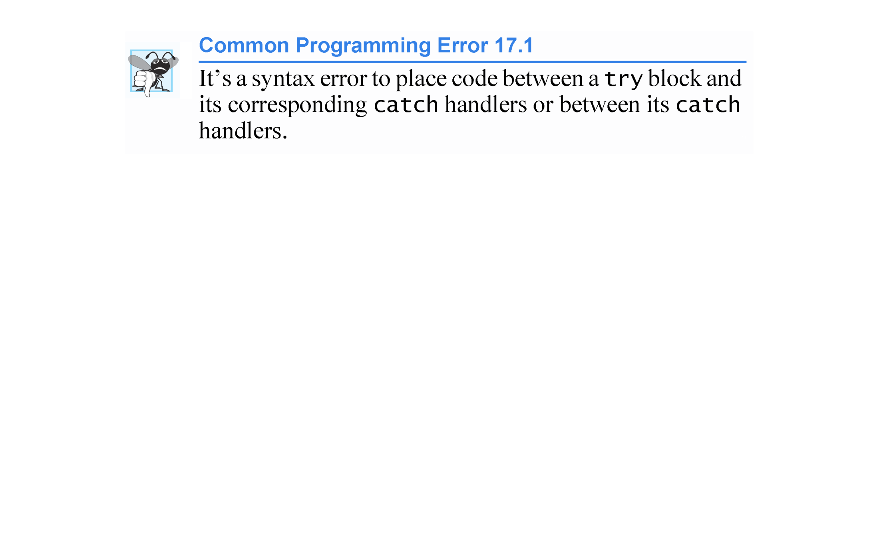

Slide 24
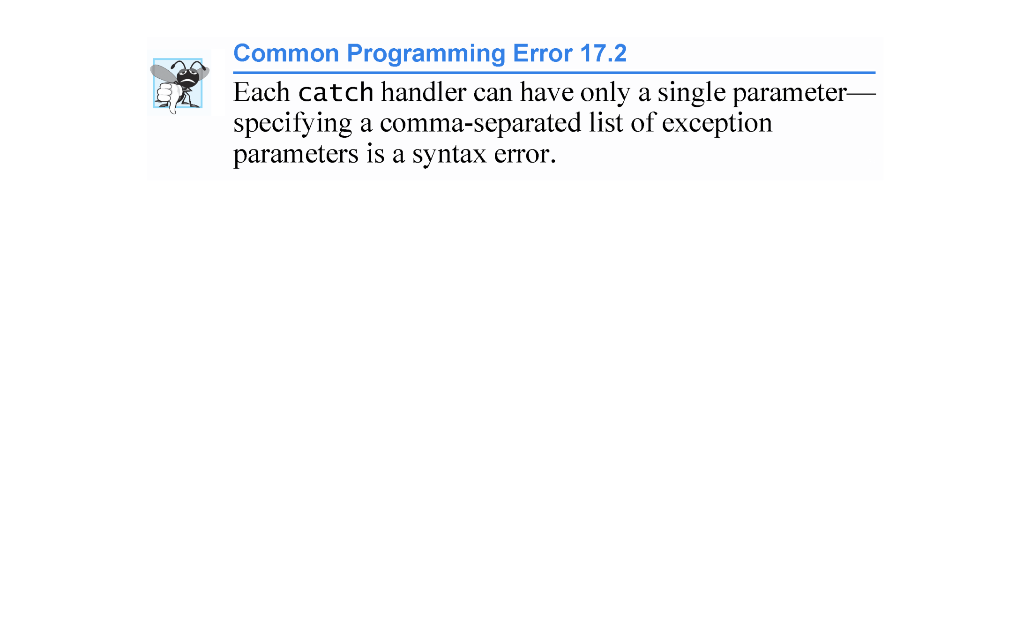

Slide 25
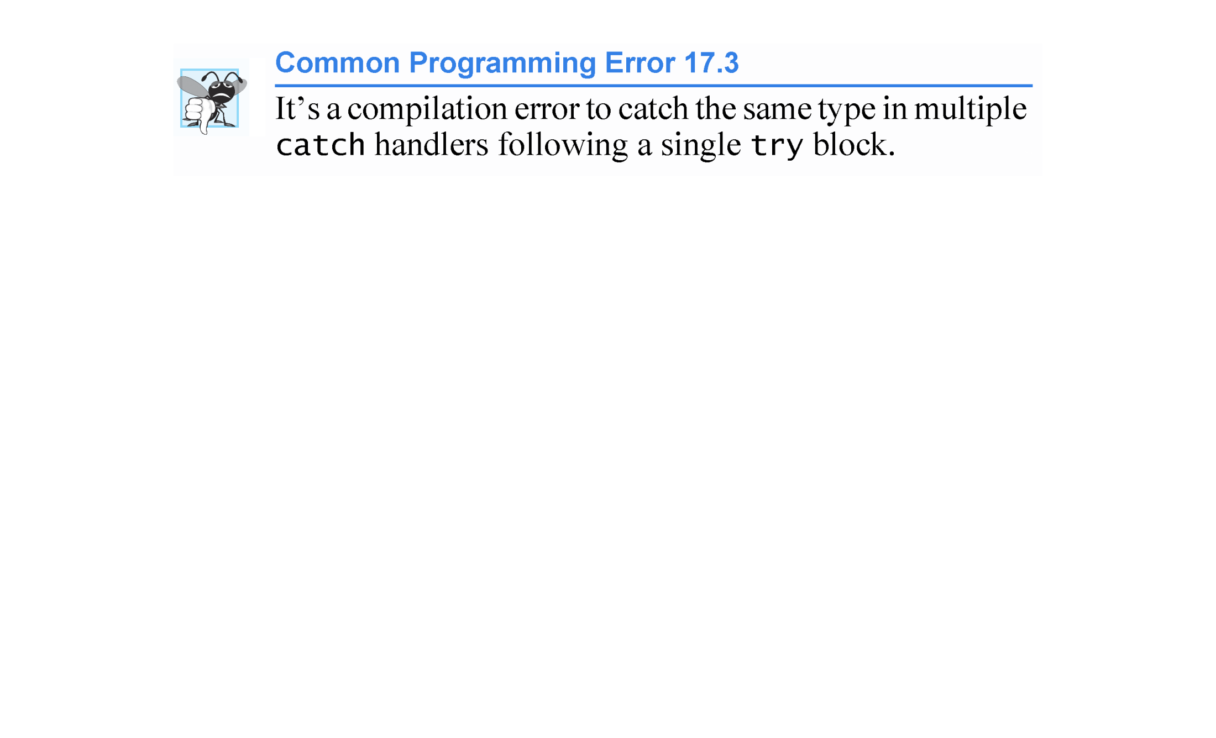

Slide 26
17.2 Example: Attempt to Divide by Zero (cont.)
Termination Model of Exception Handling
If an exception occurs as the result of a statement in a try block, the try block expires (i.e., terminates immediately).
Next, the program searches for the first catch handler that can process the type of exception that occurred.
The program locates the matching catch by comparing the thrown exception’s type to each catch’s exception-parameter type until the program finds a match.
A match occurs if the types are identical or if the thrown exception’s type is a derived class of the exception-parameter type.
When a match occurs, the code in the matching catch handler executes.

Slide 27
17.2 Example: Attempt to Divide by Zero (cont.)
When a catch handler finishes processing by reaching its closing right brace (}), the exception is considered handled and the local variables defined within the catch handler (including the catch parameter) go out of scope.
Program control does not return to the point at which the exception occurred (known as the throw point), because the try block has expired.
Rather, control resumes with the first statement after the last catch handler following the try block.
This is known as the termination model of exception handling.
As with any other block of code, when a try block terminates, local variables defined in the block go out of scope.

Slide 28


Slide 29
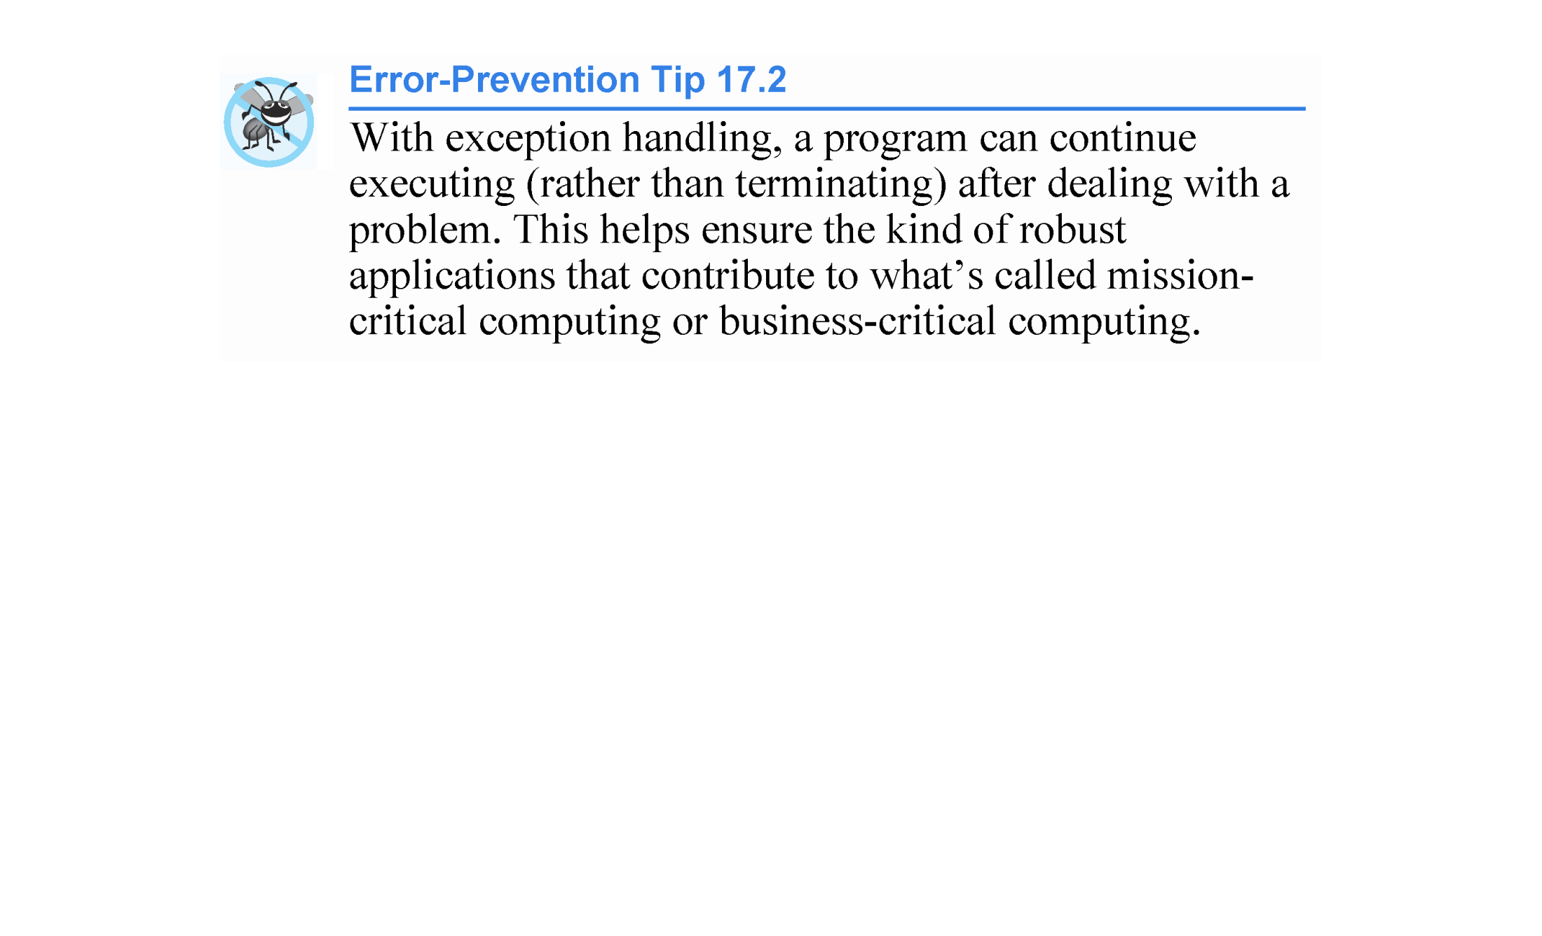

Slide 30
17.2 Example: Attempt to Divide by Zero (cont.)
If the try block completes its execution successfully (i.e., no exceptions occur in the try block), then the program ignores the catch handlers and program control continues with the first statement after the last catch following that try block.
If an exception that occurs in a try block has no matching catch handler, or if an exception occurs in a statement that is not in a try block, the function that contains the statement terminates immediately, and the program attempts to locate an enclosing try block in the calling function.
This process is called stack unwinding and is discussed in Section 17.4.

Slide 31
17.2 Example: Attempt to Divide by Zero (cont.)
Flow of Program Control When the User Enters a Denominator of Zero
As part of throwing an exception, the throw operand is created and used to initialize the parameter in the catch handler, which we discuss momentarily.
Central characteristic of exception handling: If your program explicitly throws an exception, it should do so before the error has an opportunity to occur.
In general, when an exception is thrown within a try block, the exception is caught by a catch handler that specifies the type matching the thrown exception.

Slide 32
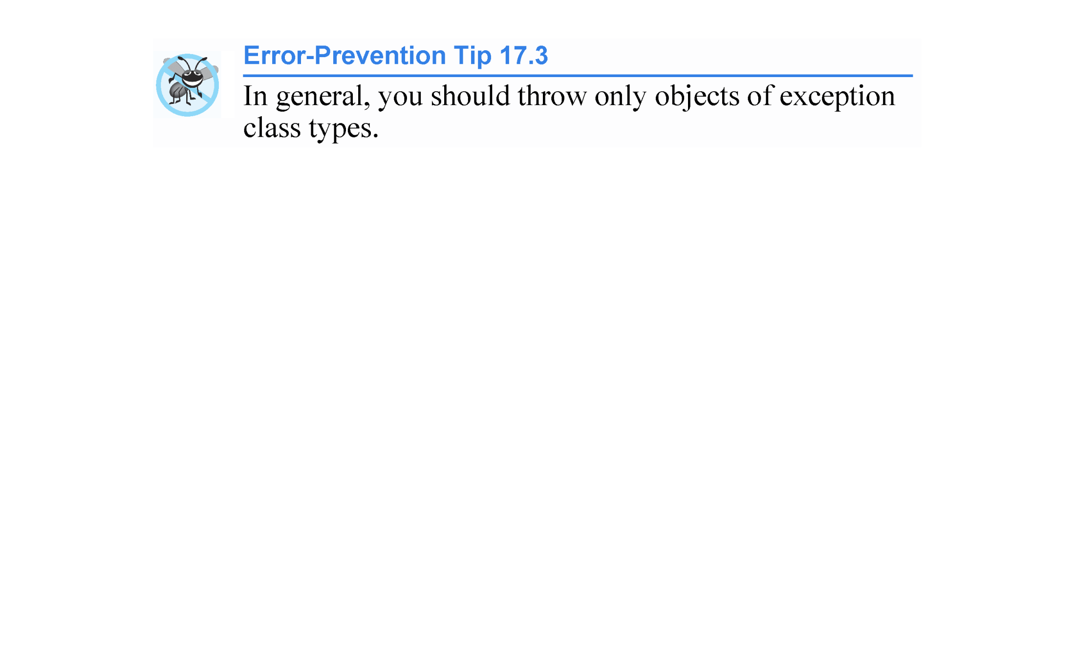

Slide 33
17.2 Example: Attempt to Divide by Zero (cont.)
In this program, the catch handler specifies that it catches DivideByZeroException objects - this type matches the object type thrown in function quotient.
Actually, the catch handler catches a reference to the DivideByZeroException object created by function quotient’s throw statement.
The exception object is maintained by the exception-handling mechanism.

Slide 34


Slide 35
17.3 Rethrowing an Exception
A function might use a resource—like a file—and might want to release the resource (i.e., close the file) if an exception occurs.
An exception handler, upon receiving an exception, can release the resource then notify its caller than an exception occurred by rethrowing the exception via the statement
throw; //no exception parameter needed
Regardless of whether a handler can process an exception, the handler can rethrow the exception for further processing outside the handler.
The next enclosing try block detects the rethrown exception, which a catch handler listed after that enclosing try block attempts to handle.

Slide 36
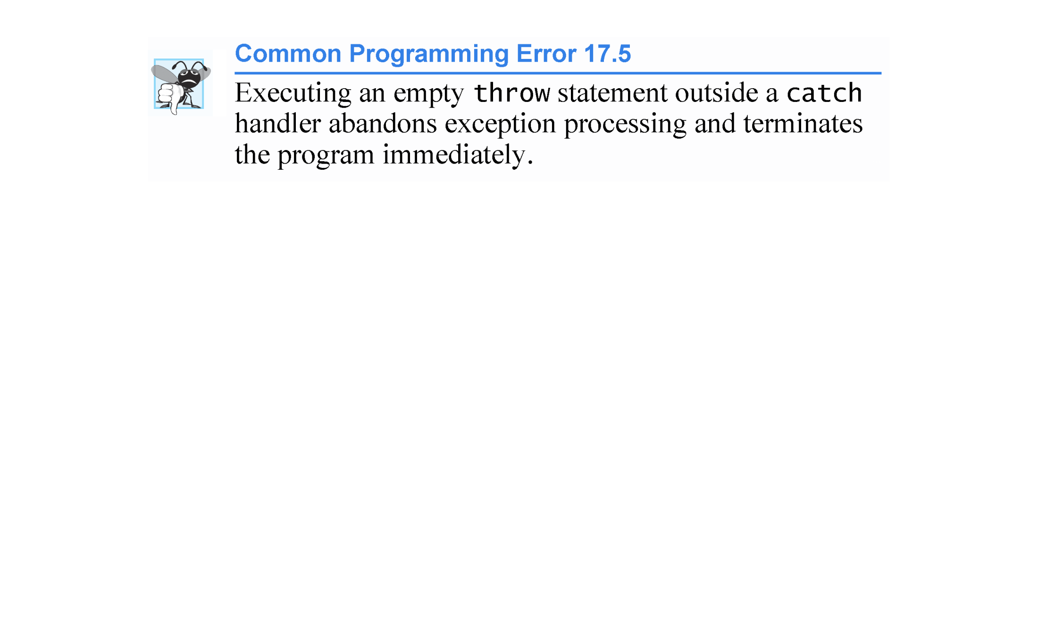

Slide 37
17.3 Rethrowing an Exception (cont.)
The program of Fig. 17.3 demonstrates rethrowing an exception.
Since we do not use the exception parameters in the catch handlers of this example, we omit the exception parameter names and specify only the type of exception to catch (lines 16 and 35).

Slide 38
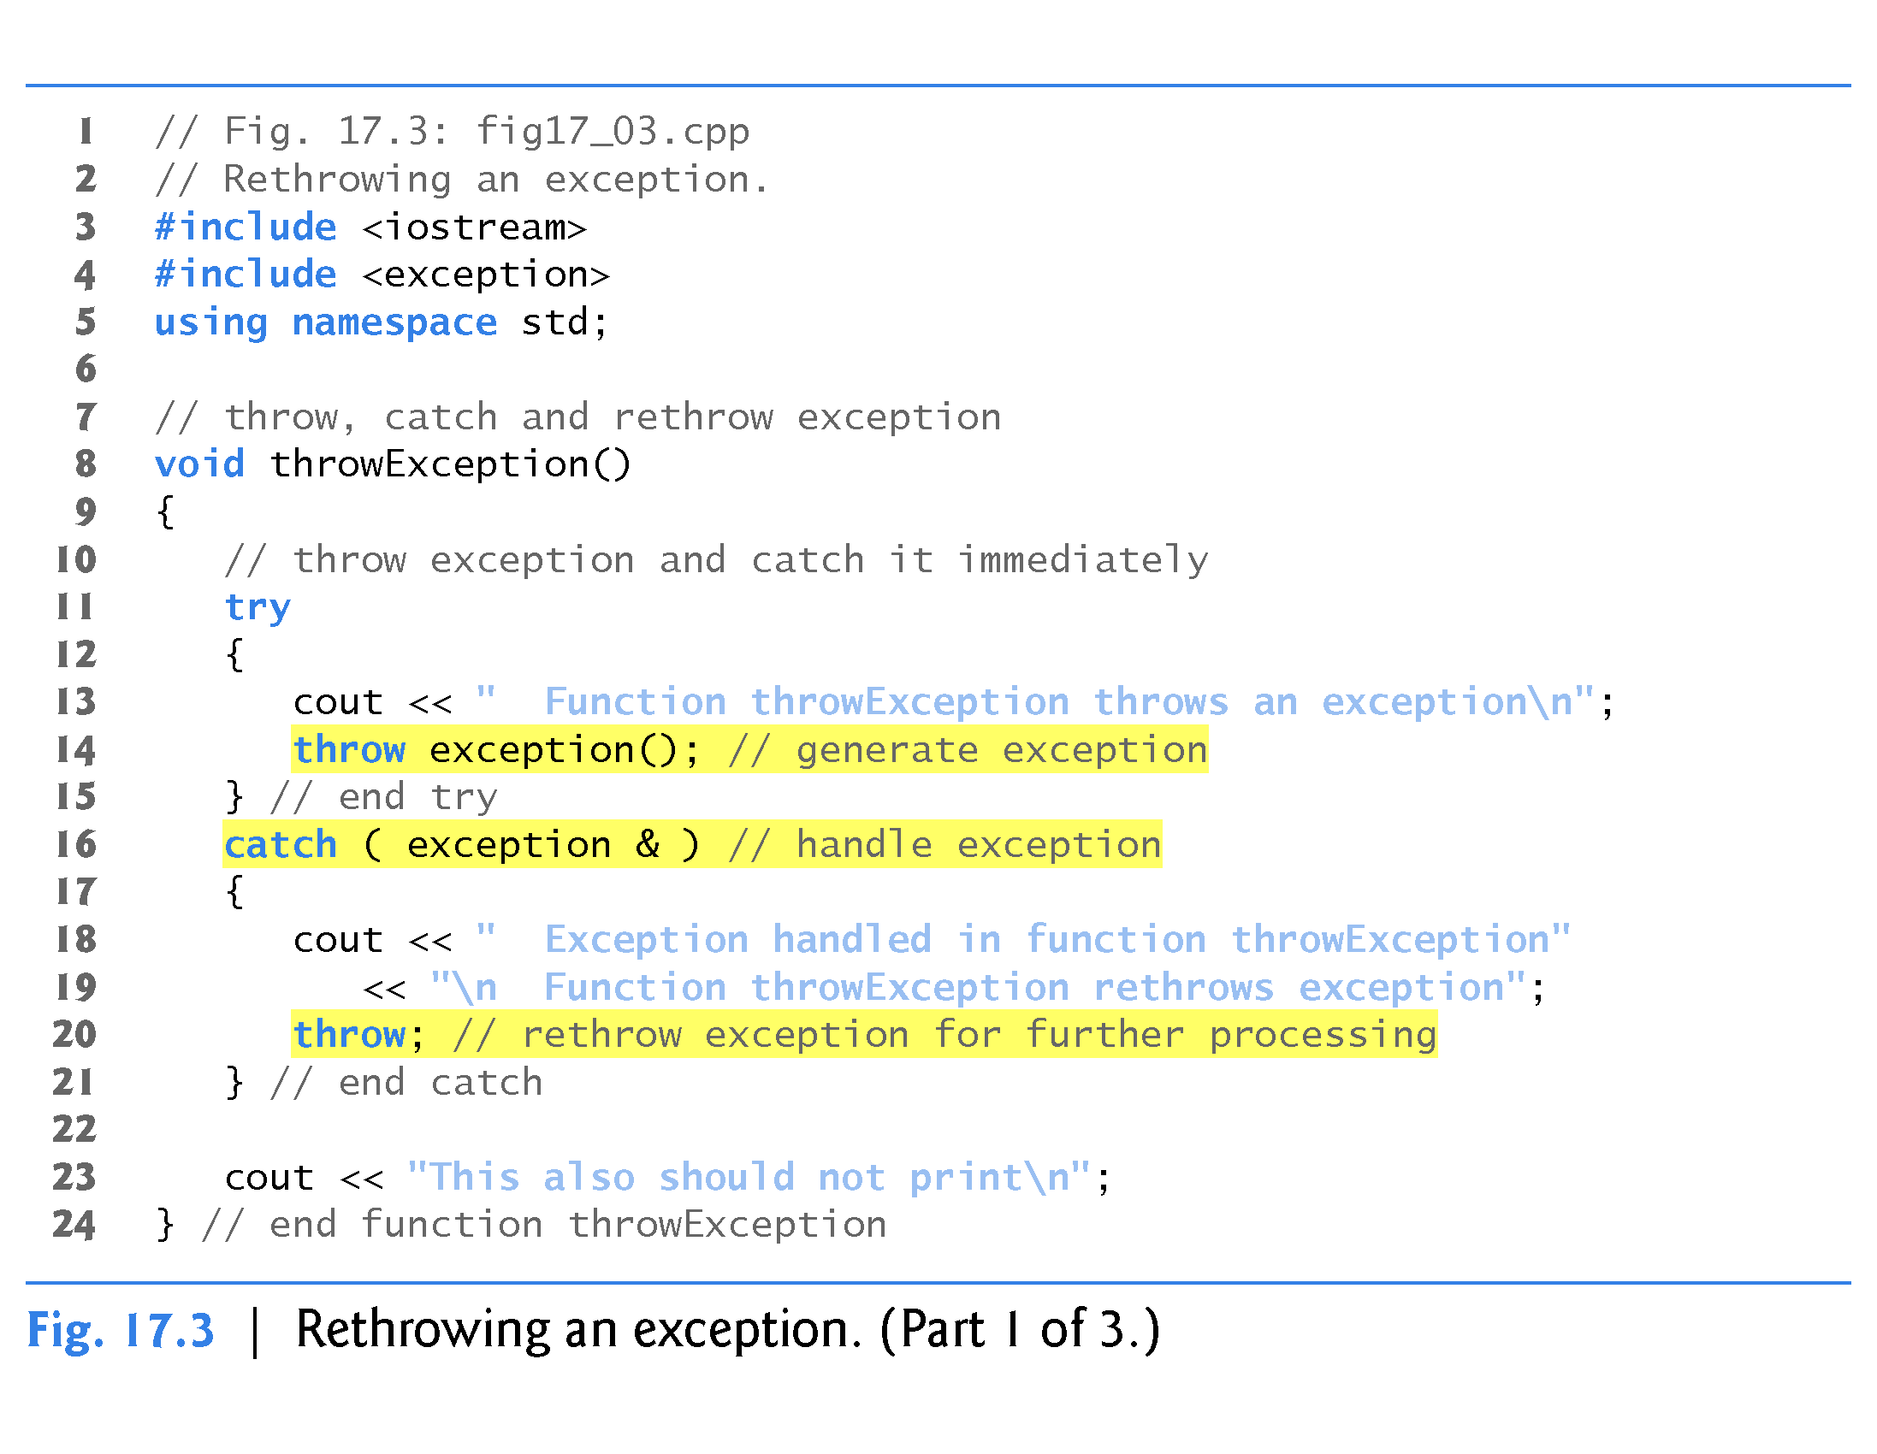
exception is a header file and a class name
No exception parameter names in this example.

Slide 39
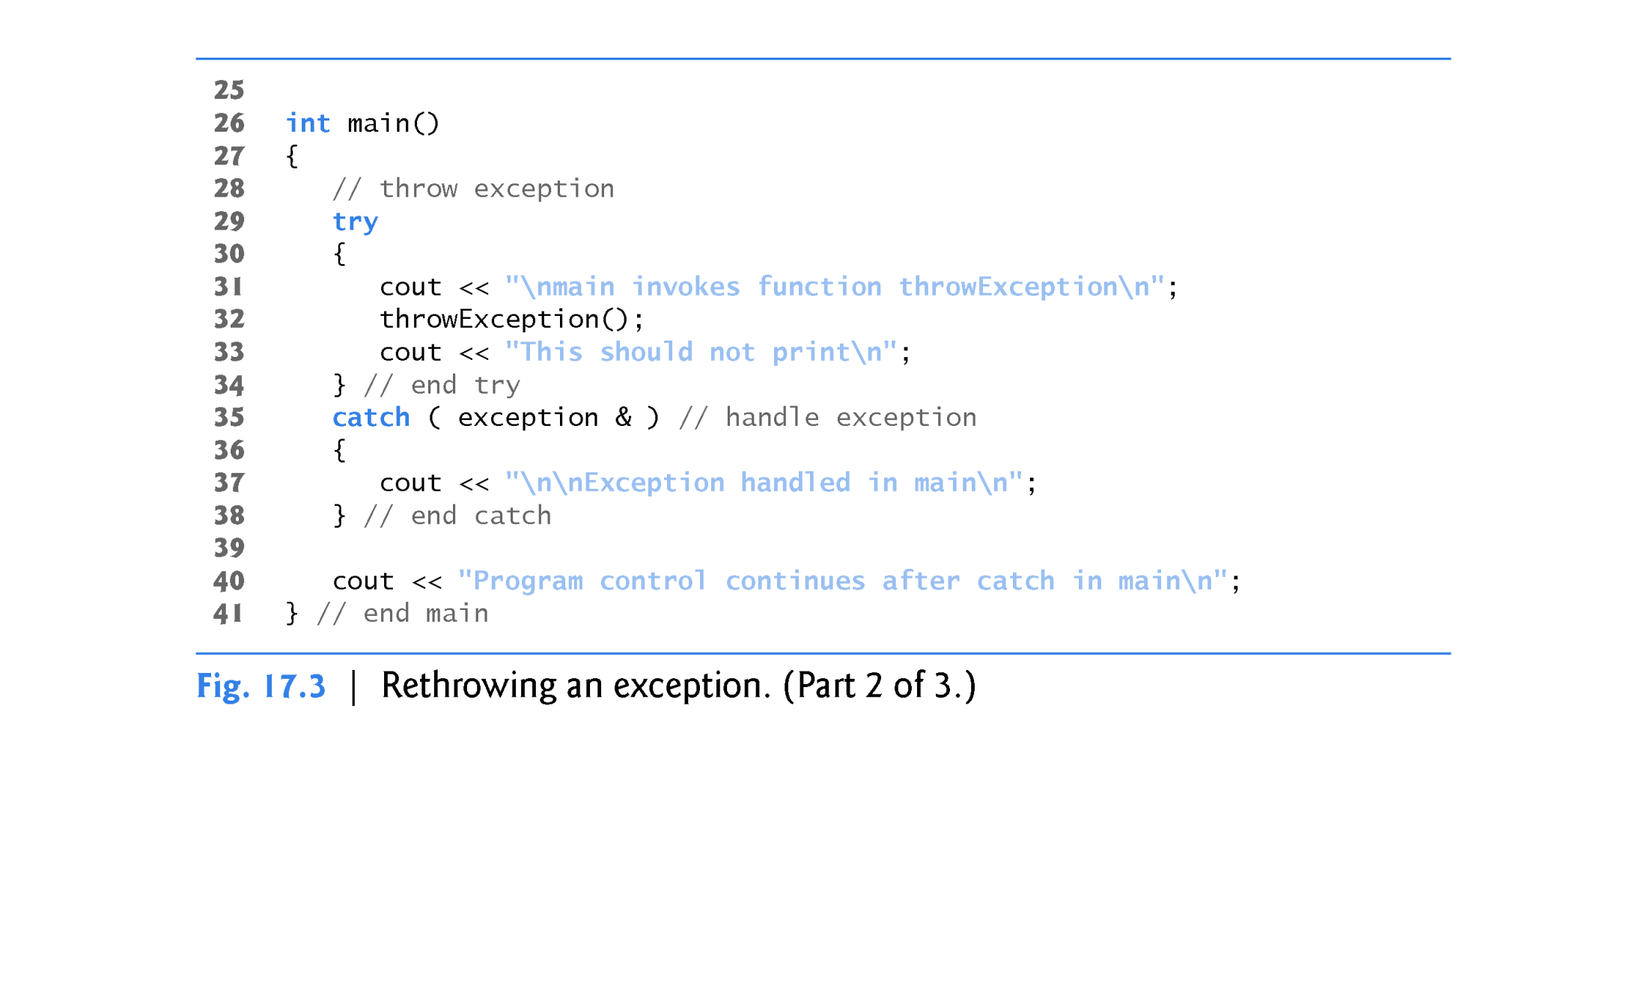

Slide 40
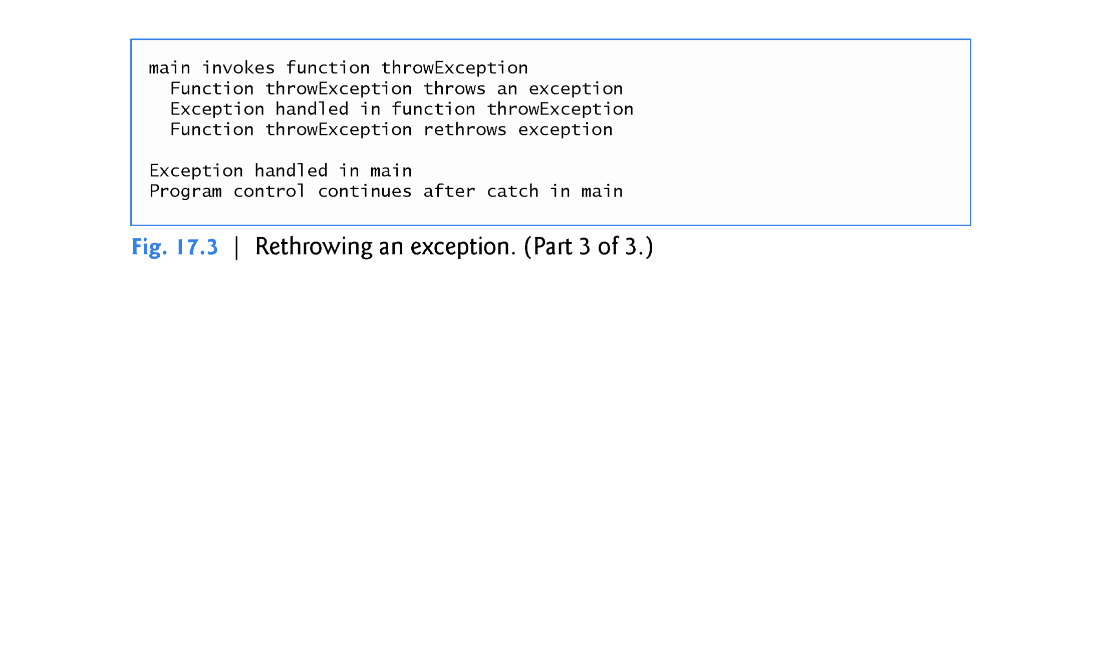

Slide 41
17.4 Stack Unwinding
When an exception is thrown but not caught in a particular scope, the function call stack is “unwound,” and an attempt is made to catch the exception in the next outer try…catch block.
Unwinding the function call stack means that the function in which the exception was not caught terminates, all local variables that have completed intitialization in that function are destroyed and control returns to the statement that originally invoked that function.
If a try block encloses that statement, an attempt is made to catch the exception.
If a try block does not enclose that statement, stack unwinding occurs again.
If no catch handler ever catches this exception, the program terminates.
The program of Fig. 17.4 demonstrates stack unwinding.

Slide 42
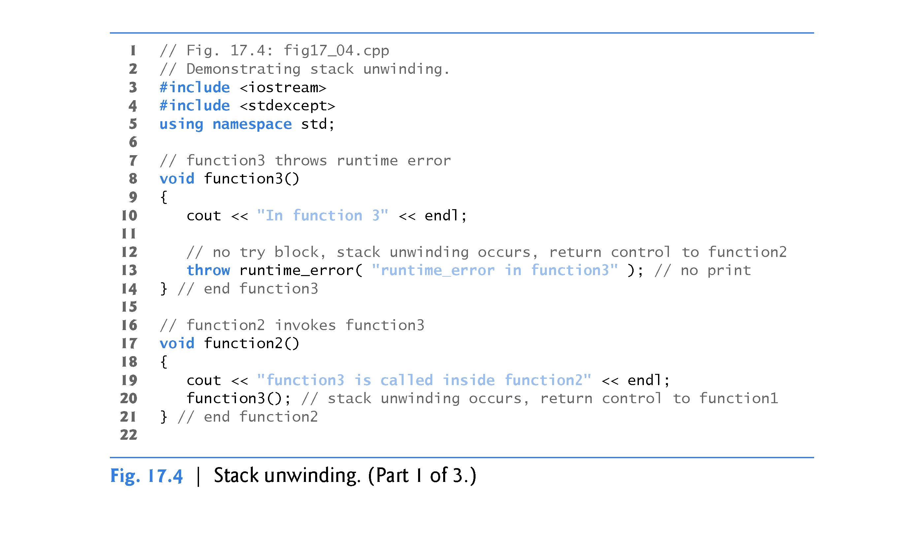

Slide 43
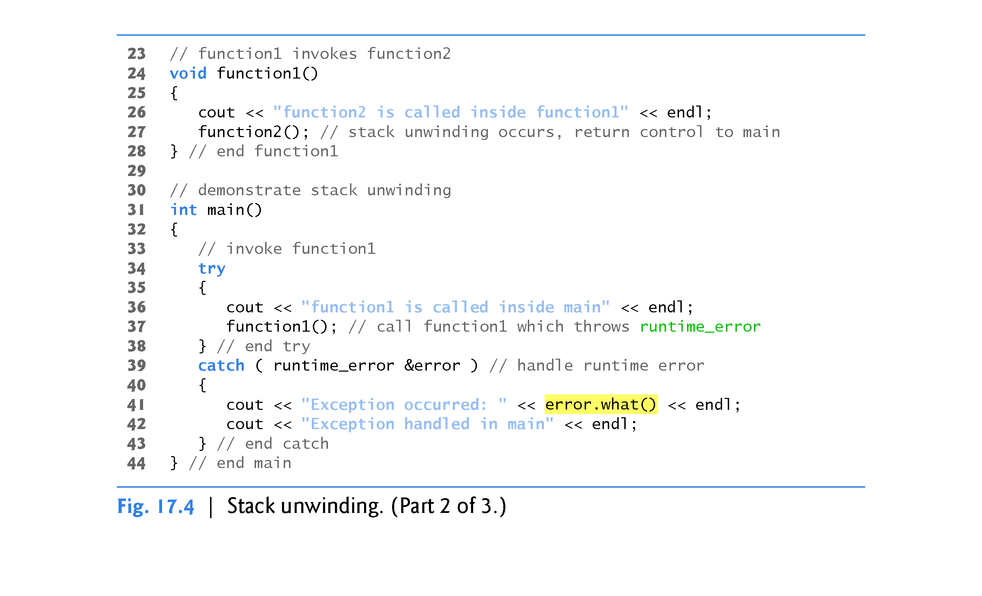

Slide 44
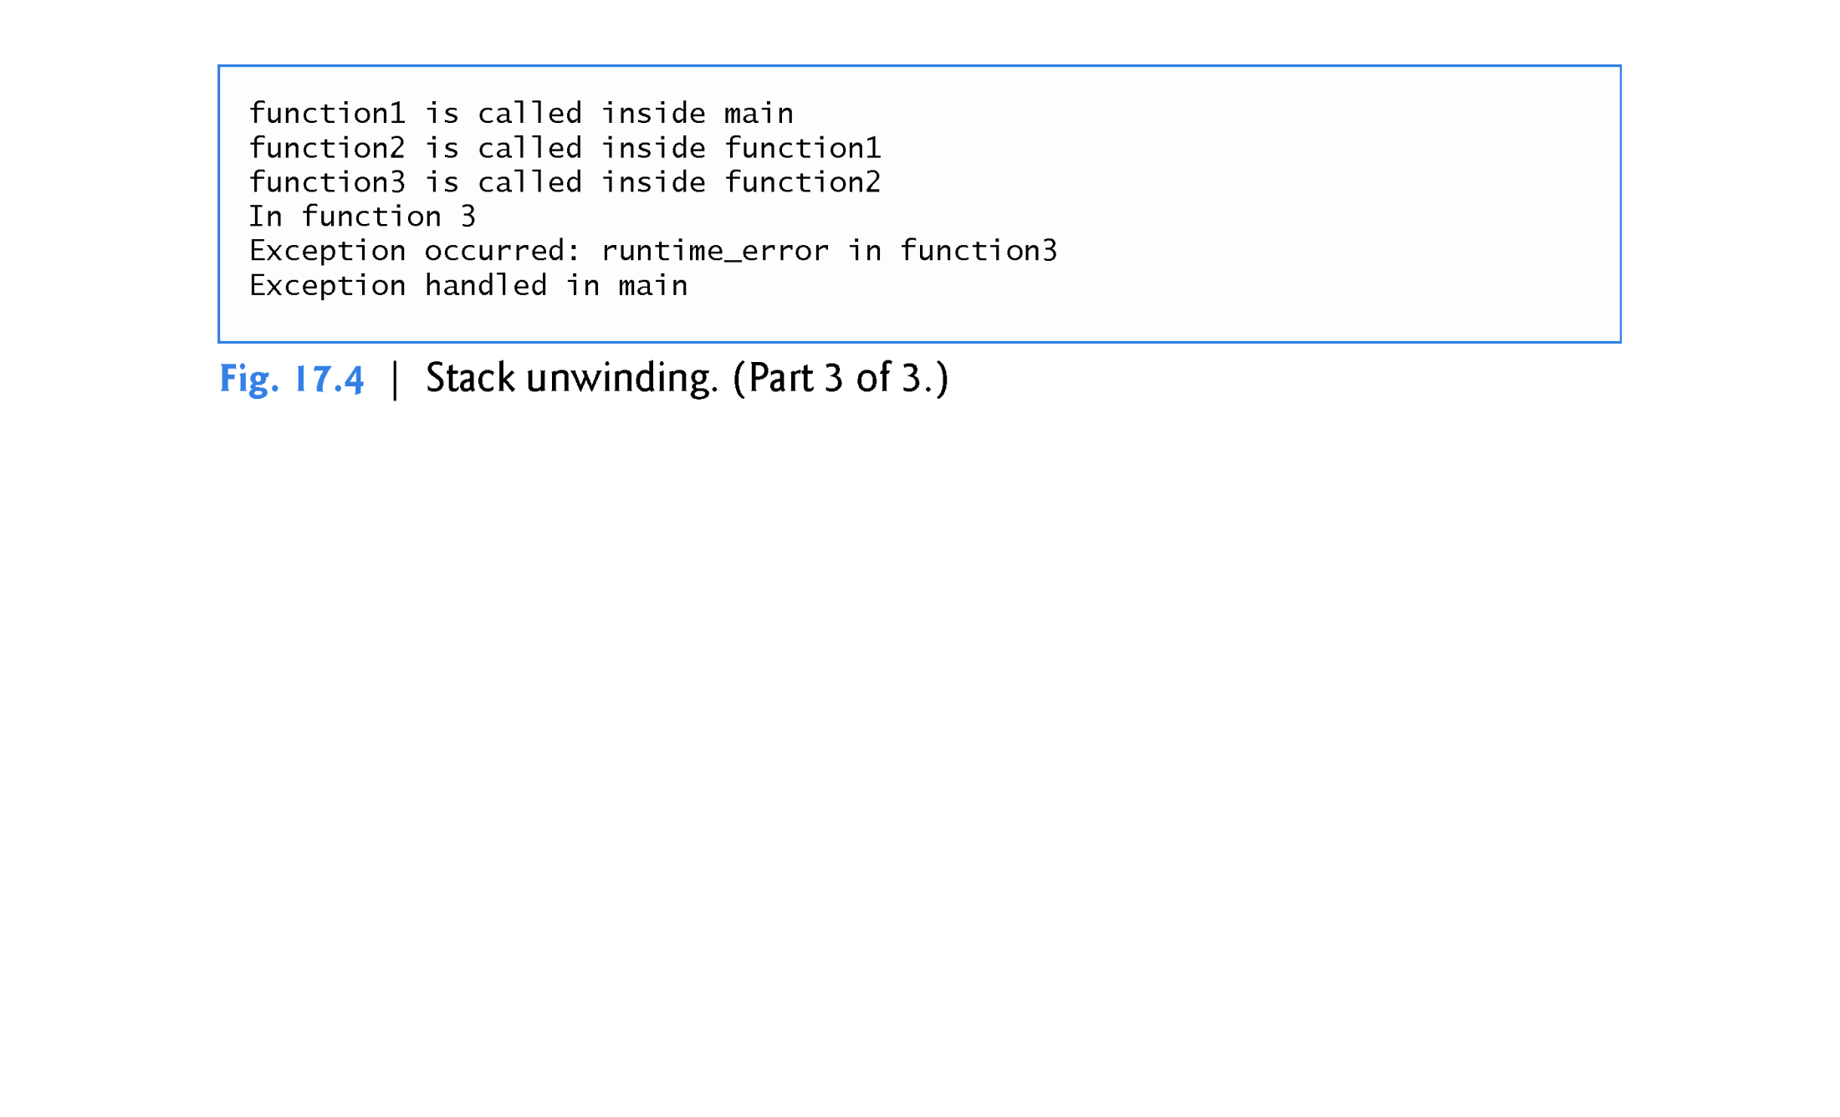

Slide 45
17.4 Stack Unwinding (cont.)
Line 13 of function3 throws a runtime_error object.
However, because no try block encloses the throw statement in line 13, stack unwinding occurs—function3 terminates at line 13, then returns control to the statement in function2 that invoked function3 (i.e., line 20).
Because no try block encloses line 20, stack unwinding occurs again—function2 terminates at line 20 and returns control to the statement in function1 that invoked function2 (i.e., line 27).
Because no try block encloses line 27, stack unwinding occurs one more time—function1 terminates at line 27 and returns control to the statement in main that invoked function1 (i.e., line 37).
The try block of lines 34–38 encloses this statement, so the first matching catch handler located after this try block (line 39–43) catches and processes the exception.

Slide 46
17.5 When to Use Exception Handling
Exception handling is designed to process synchronous errors, which occur when a statement executes, such as:
out-of-range array subscripts
arithmetic overflow (i.e., a value outside the representable range of values)
division by zero
invalid function parameters
unsuccessful memory allocation (due to lack of memory).
Exception handling is not designed to process errors associated with asynchronous events (e.g., disk I/O completions, network message arrivals, mouse clicks and keystrokes), which occur in parallel with, and independent of, the program’s flow of control.

Slide 47
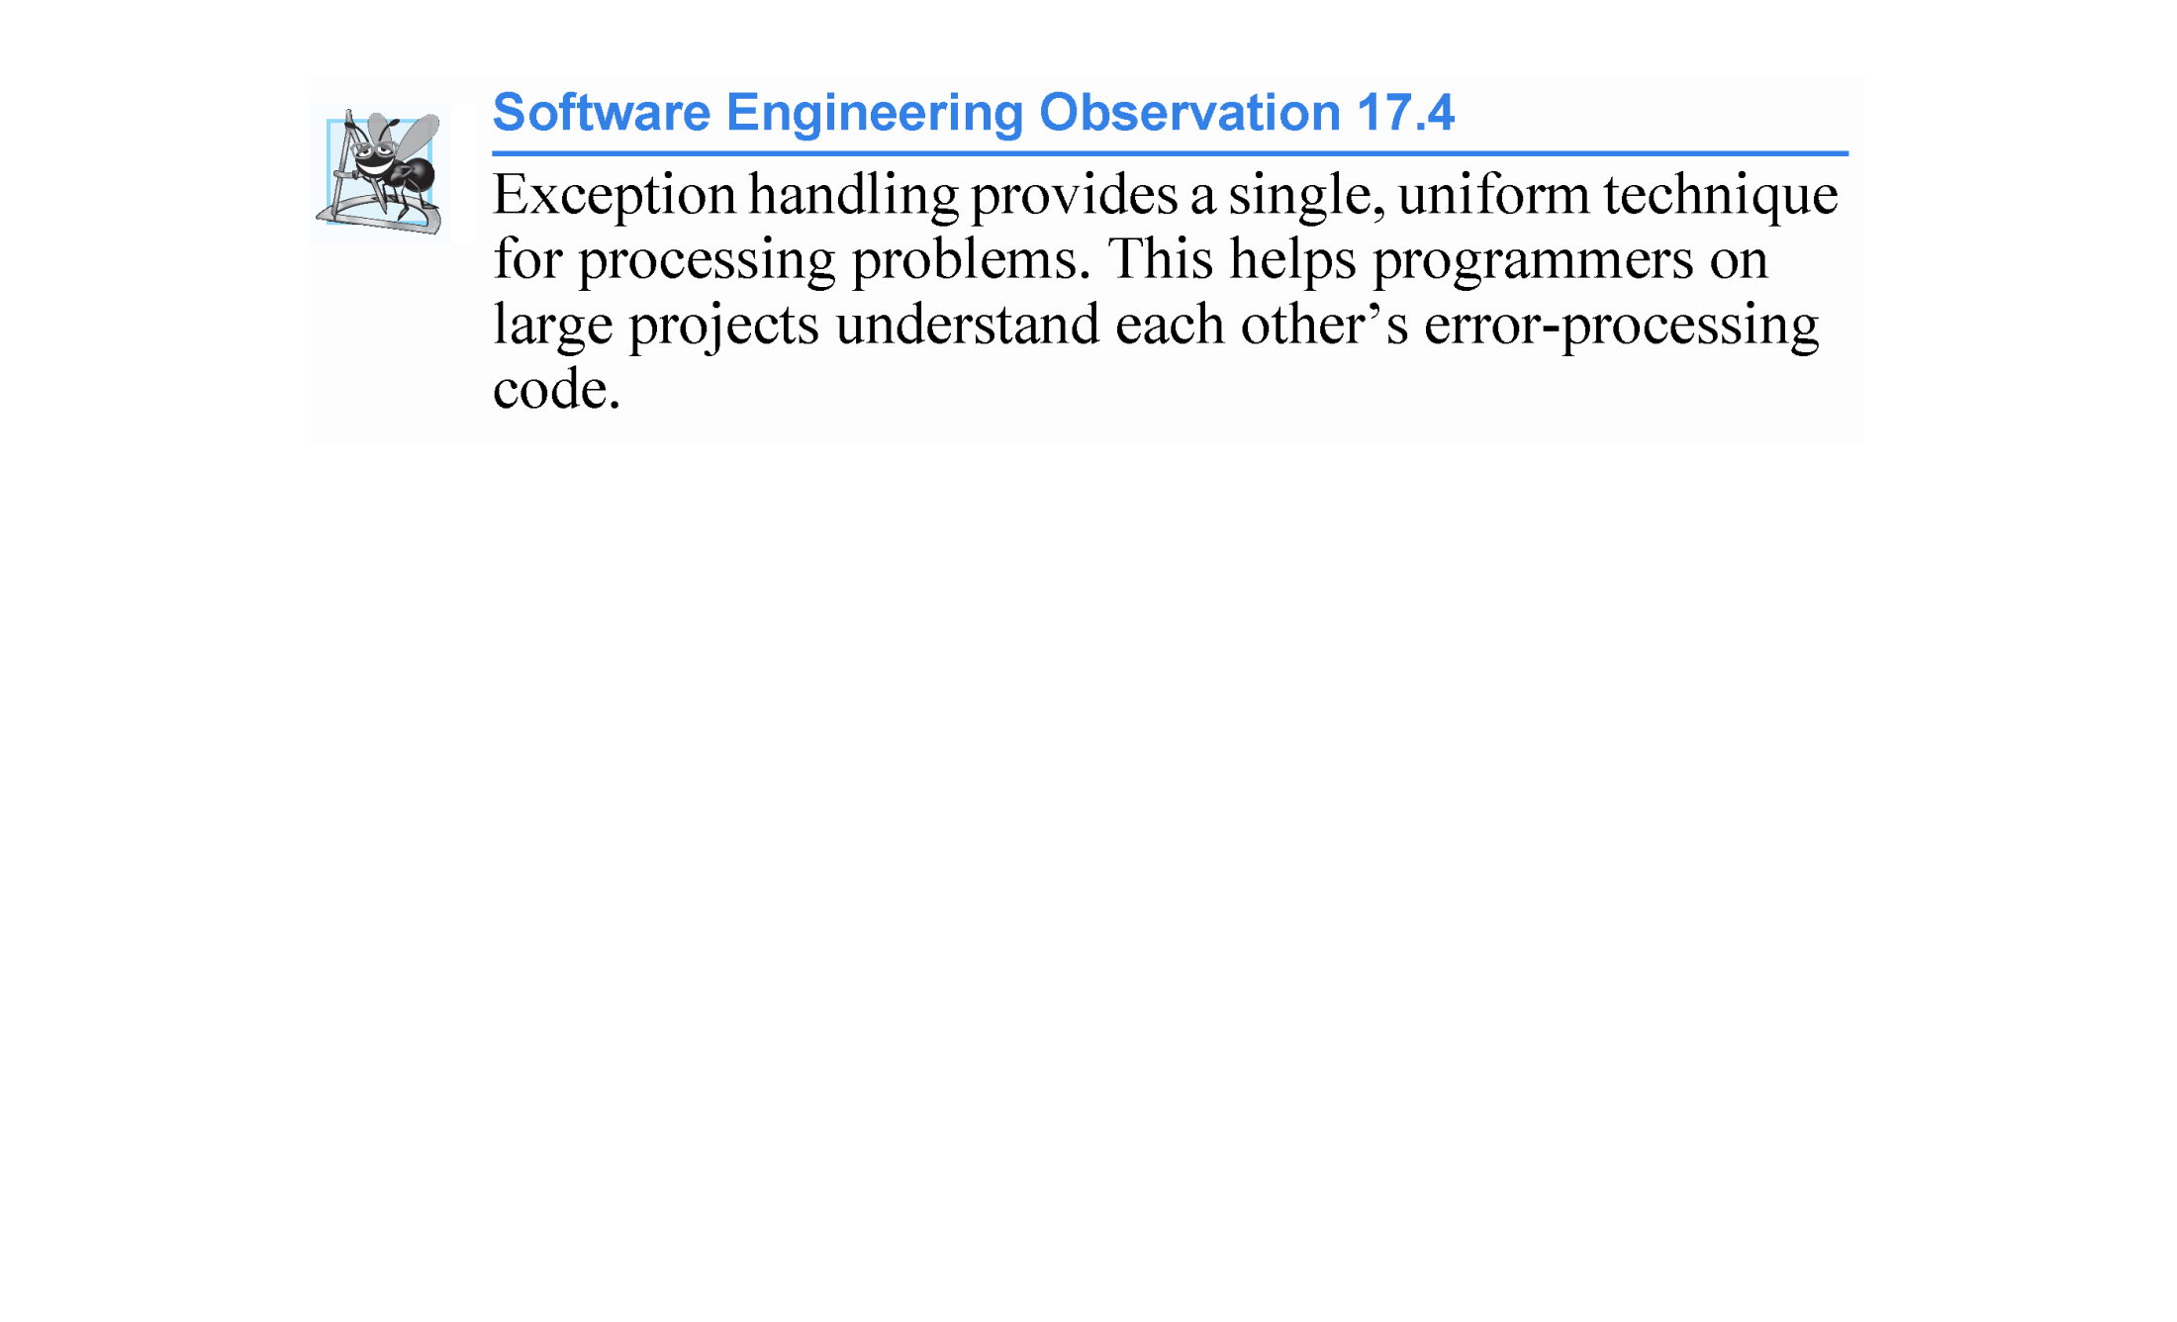

Slide 48
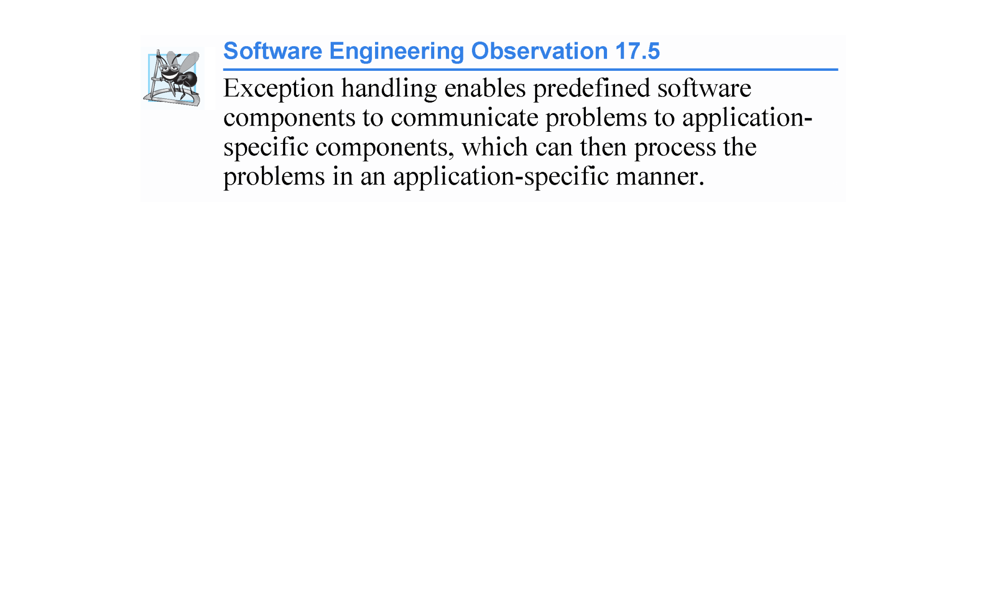

Slide 49
17.5 When to Use Exception Handling (cont.)
Exception-handling also is useful for processing problems that occur when a program interacts with software elements, such as member functions, constructors, destructors and classes.
Software elements often use exceptions to notify programs when problems occur.
This enables you to implement customized error handling for each application.

Slide 50
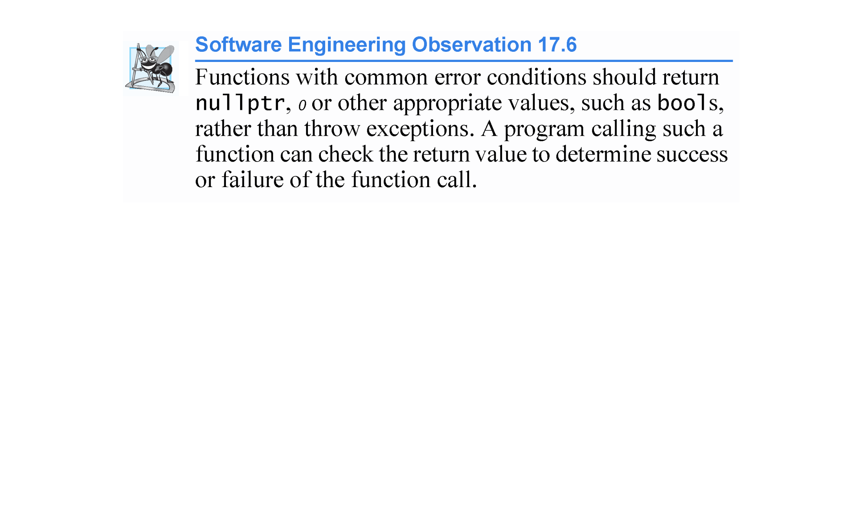

Slide 51
17.5 When to Use Exception Handling (cont.)
Complex applications normally consist of predefined software components and application-specific components that use the predefined components.
When a predefined component encounters a problem, that component needs a mechanism to communicate the problem to the application-specific component—the predefined component cannot know in advance how each application processes a problem that occurs.

Slide 52
17.5 When to Use Exception Handling (cont.)
C++11: Declaring Functions That Do Not Throw Exceptions
As of C++11, if a function does not throw any exceptions and does not call any functions that throw exceptions, you should explicitly state that a function does not throw exceptions.
This indicates to client-code programmers that there’s no need to place calls to the function in a try block.
Add noexcept to the right of the function’s parameter list in both the prototype and the definition.
For a const member function, place noexcept after const.
If a function that’s declared noexcept calls another function that throws an exception or executes a throw statement, the program terminates.

Slide 53
17.6 Constructors, Destructors and Exception Handling
What happens when an error is detected in a constructor?
For example, how should an object’s constructor respond when it receives invalid data?
Because a constructor cannot return a value to indicate an error, we must choose an alternative means of indicating that the object has not been constructed properly.
One scheme is to return the improperly constructed object and hope that anyone using it would make appropriate tests to determine that it’s in an inconsistent state.
Another scheme is to set some variable outside the constructor.

Slide 54
17.6 Constructors, Destructors and Exception Handling (cont.)
The preferred alternative is to require the constructor to throw an exception that contains the error information, thus offering an opportunity for the program to handle the failure.
Before an exception is thrown by a constructor, destructors are called for any member objects whose constructors have run to completion as part of the object being constructed.
Destructors are called for every automatic object constructed in a try block before the exception is caught.
Stack unwinding is guaranteed to have been completed at the point that an exception handler begins executing.
If a destructor invoked as a result of stack unwinding throws an exception, the program terminates.
This has been linked to various security attacks.

Slide 55


Slide 56
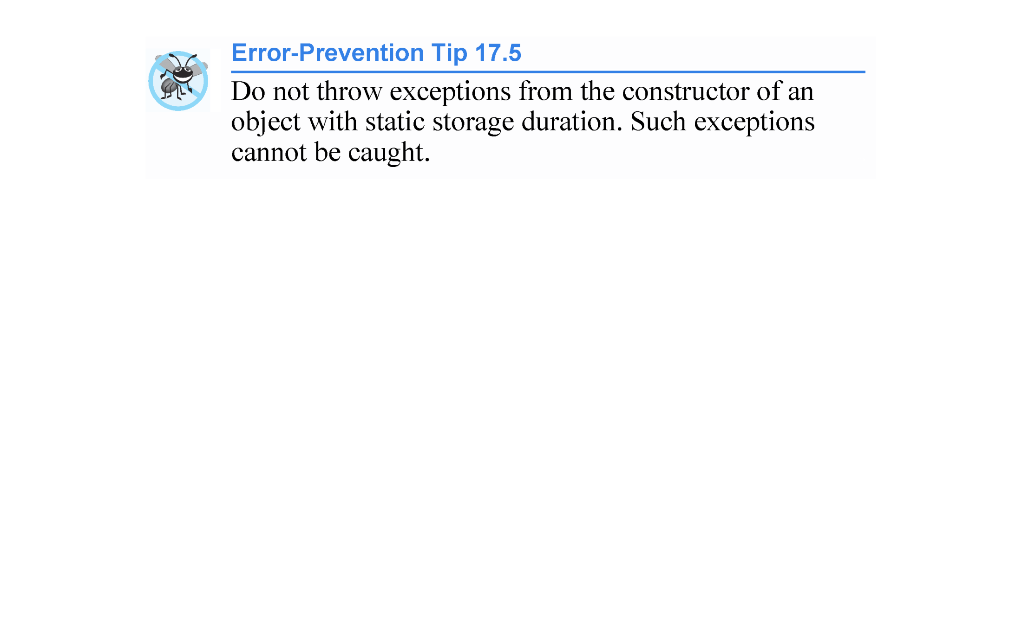

Slide 57
17.6 Constructors, Destructors and Exception Handling (cont.)
If an object has member objects, and if an exception is thrown before the outer object is fully constructed, then destructors will be executed for the member objects that have been constructed prior to the occurrence of the exception.
If an array of objects has been partially constructed when an exception occurs, only the destructors for the constructed objects in the array will be called.

Slide 58
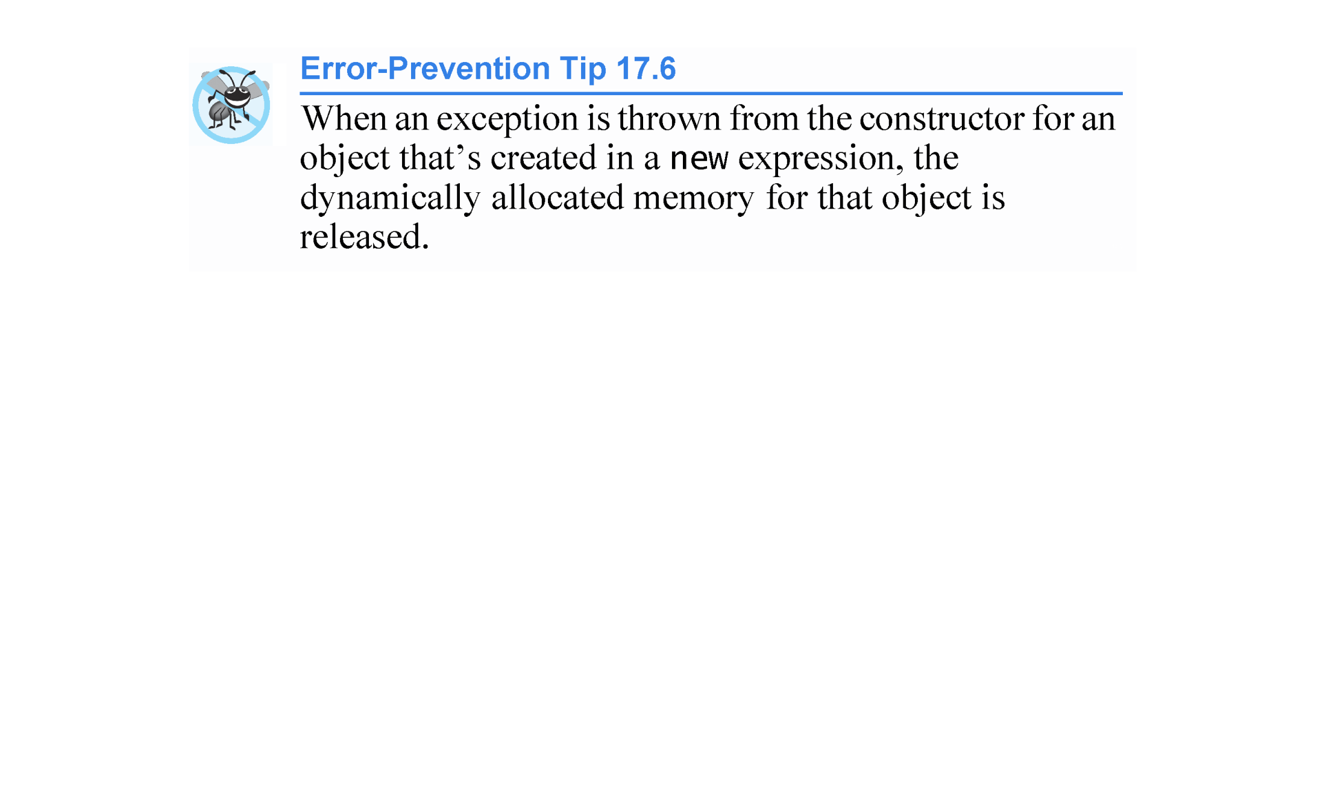

Slide 59
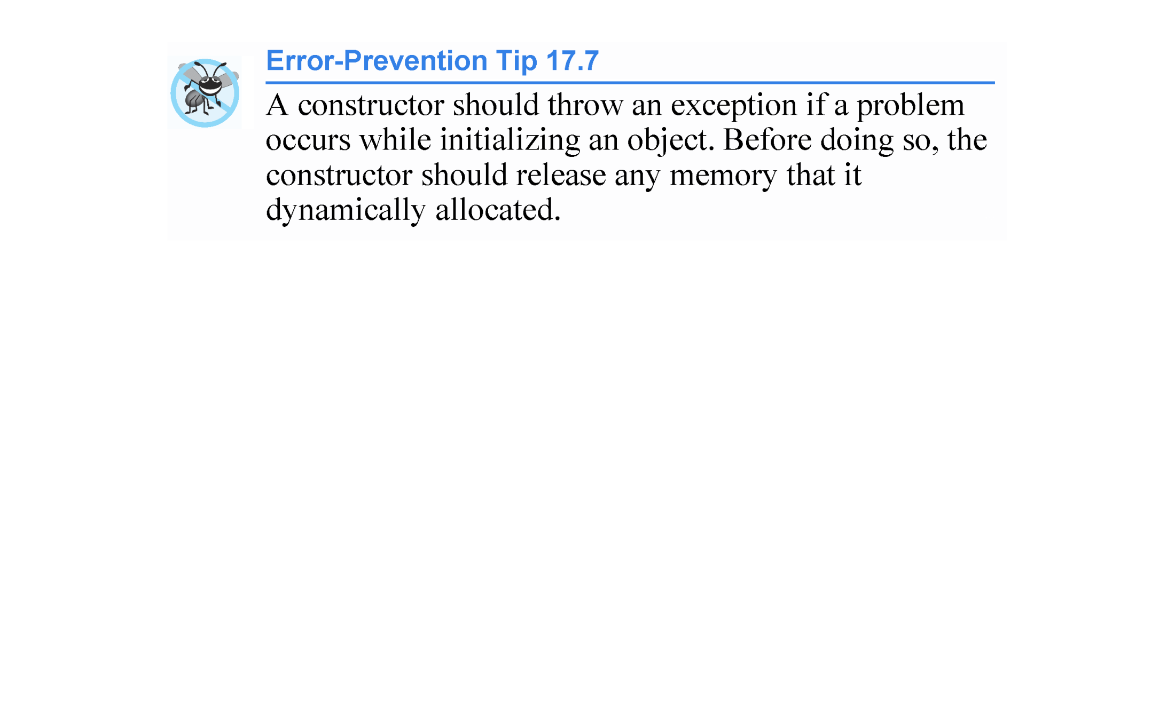

Slide 60
17.6 Constructors, Destructors and Exception Handling (cont.)
Initializing Local Objects to Acquire Resources
An exception could preclude the operation of code that would normally release a resource (such as memory or a file), thus causing a resource leak that prevents other programs from acquiring the resource.
One technique to resolve this problem is to initialize a local object to acquire the resource.
When an exception occurs, the destructor for that object will be invoked and can free the resource.

Slide 61
17.7 Exceptions and Inheritance
Various exception classes can be derived from a common base class, as we discussed in Section 17.2, when we created class DivideByZeroException as a derived class of class exception.
If a catch handler catches a reference to an exception object of a base-class type, it also can catch a reference to all objects of classes publicly derived from that base class - this allows for polymorphic processing of related exceptions.

Slide 62
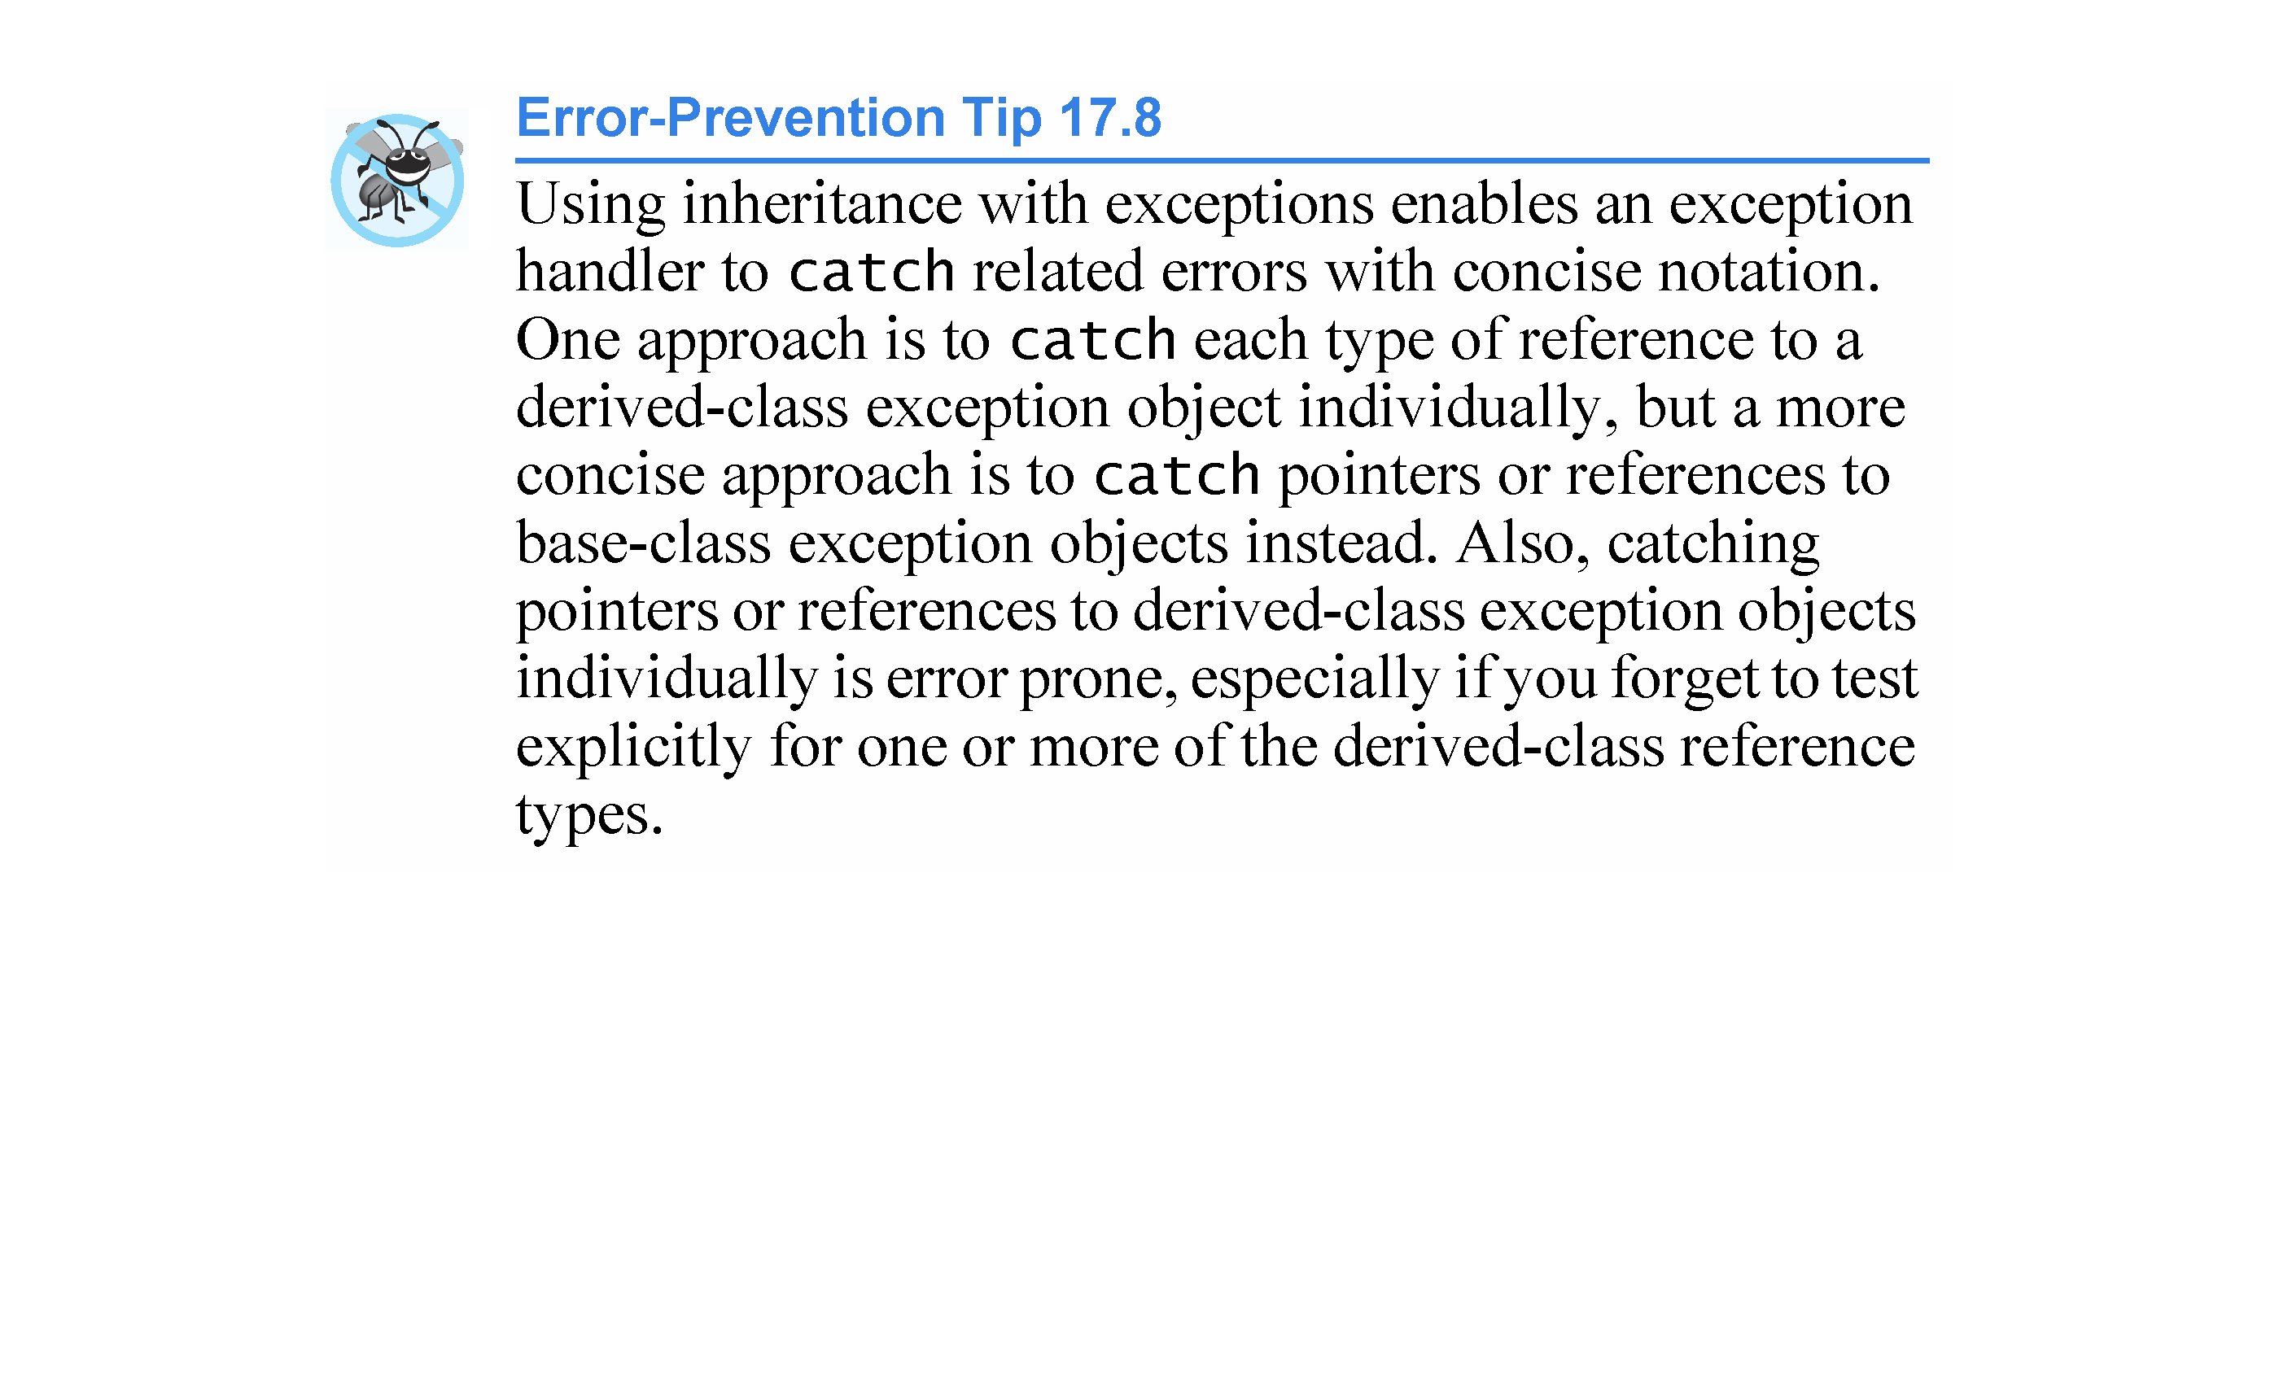

Slide 63
17.8 Processing new Failures
When operator new fails, it throws a bad_alloc exception (defined in header file <new>).
In this section, we present two examples of new failing.
The first uses the version of new that throws a bad_alloc exception when new fails.
The second uses function set_new_handler to handle new failures.
[Note: The examples in Figs. 17.5–17.6 allocate large amounts of dynamic memory, which could cause your computer to become sluggish.]

Slide 64
17.8 Processing new Failures (cont.)
new Throwing bad_alloc on Failure
Figure 17.5 demonstrates new implicitly throwing bad_alloc on failure to allocate the requested memory.
The for statement (lines 16–20) inside the try block should loop 50 times and, on each pass, allocate an array of 50,000,000 double values.
If new fails and throws a bad_alloc exception, the loop terminates, and the program continues in line 22, where the catch handler catches and processes the exception.

Slide 65
17.8 Processing new Failures (cont.)
Lines 24–25 print the message "Exception occurred:" followed by the message returned from the base-class-exception version of function what (i.e., an implementation-defined exception-specific message, such as “bad allocation " in Microsoft Visual C++).
The output shows that the program performed only four iterations of the loop before new failed and threw the bad_alloc exception.
Your output might differ based on the physical memory, disk space available for virtual memory on your system and the compiler you are using.

Slide 66
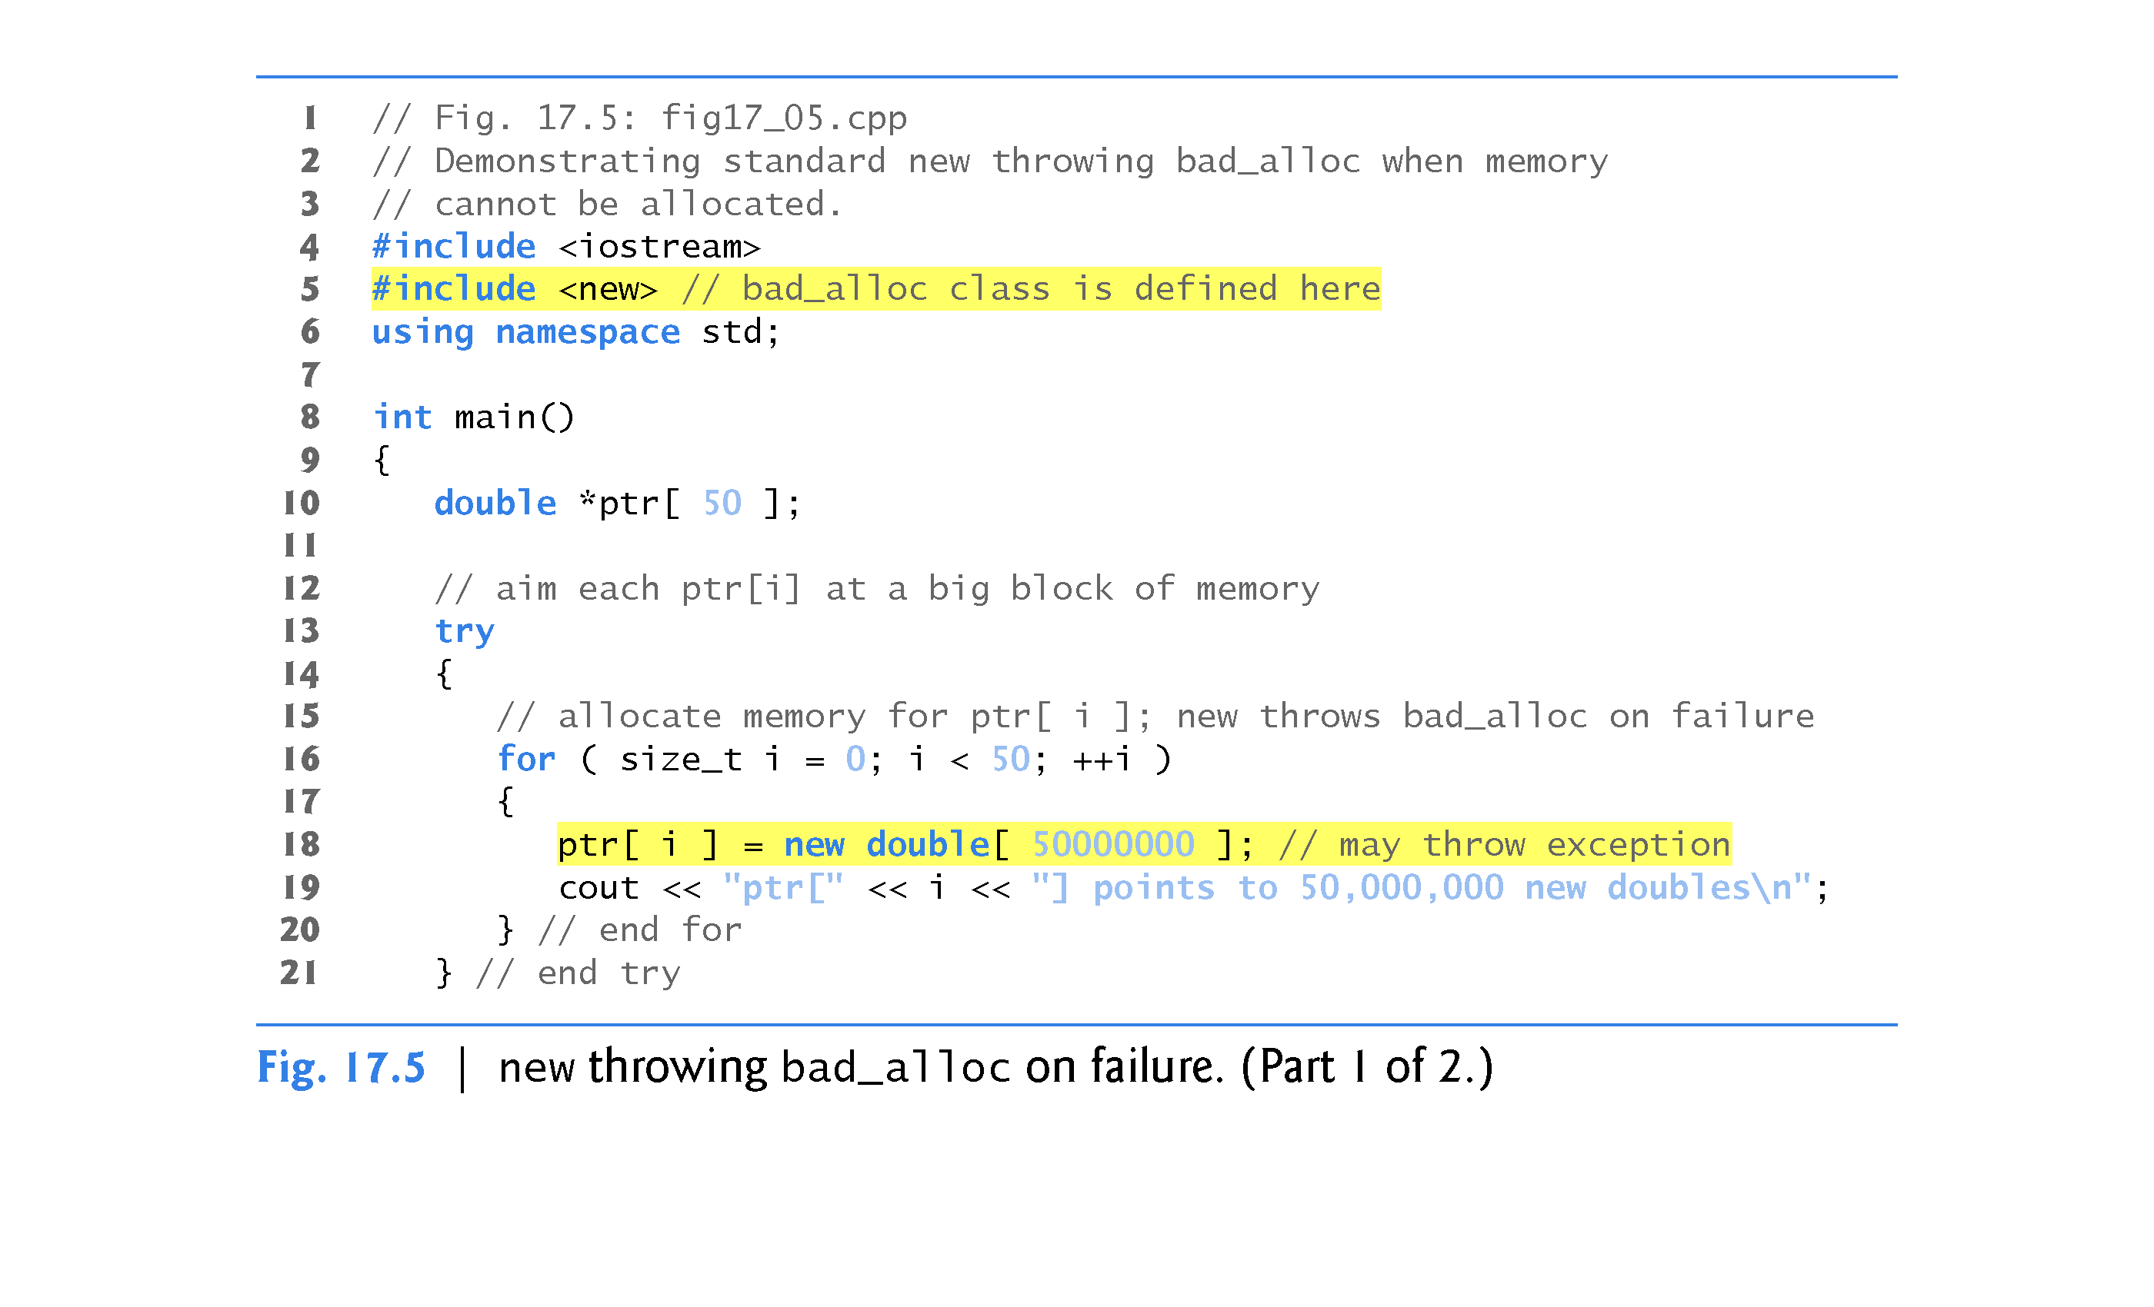
recall that size_t is a synonym for unsigned int

Slide 67
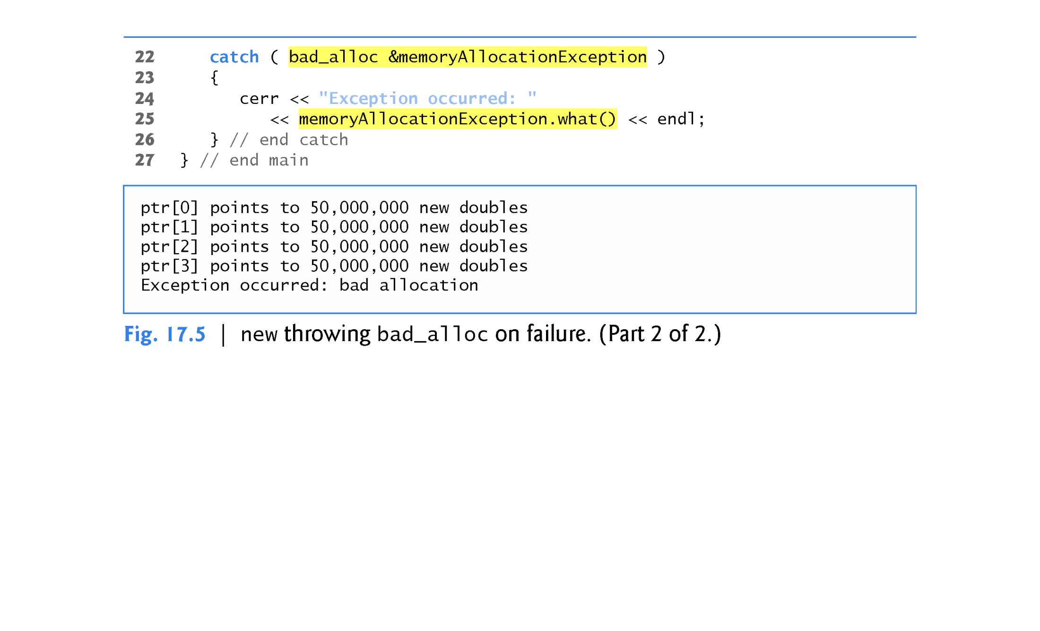

Slide 68
17.8 Processing new Failures (cont.)
new Returning nullptr on Failure
The C++ standard specifies that programmers can use an older version of new that returns nullptr upon failure.
For this purpose, header <new> defines object nothrow (of type nothrow_t), which is used as follows:
double *ptr = new( nothrow ) double[ 50000000 ];
The preceding statement uses the version of new that does not throw bad_alloc exceptions (i.e., nothrow) to allocate an array of 50,000,000 doubles.

Slide 69
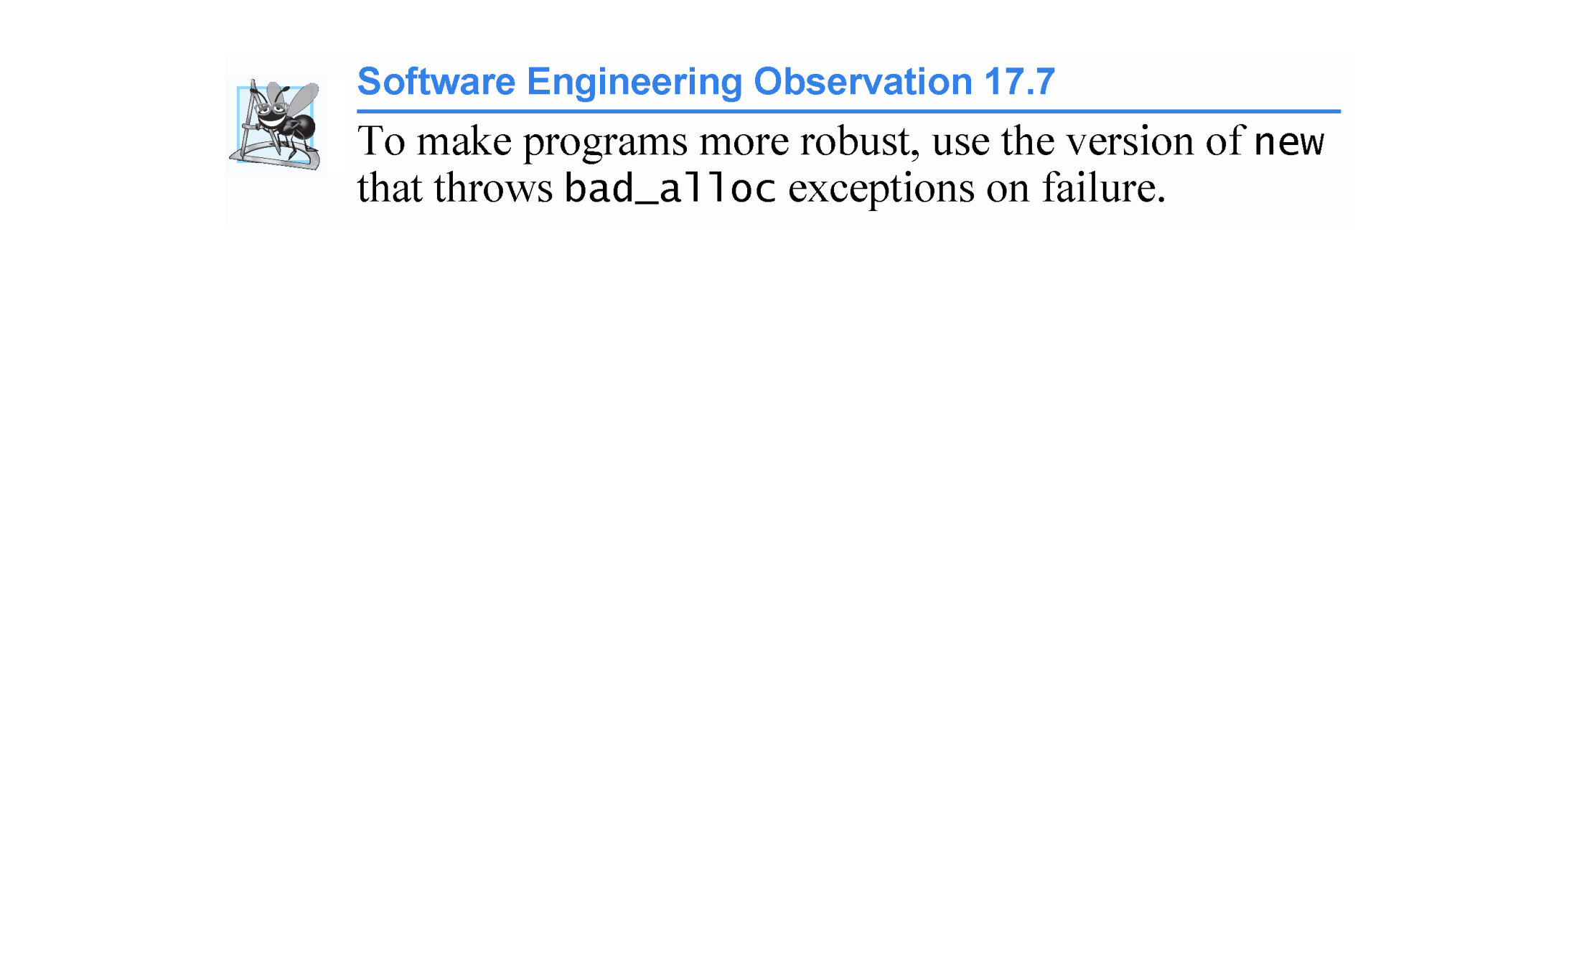

Slide 70
17.8 Processing new Failures (cont.)
Handling new Failures Using Function set_new_handler
Function set_new_handler (prototyped in standard header file <new>) takes as its argument a pointer to a function that takes no arguments and returns void.
This pointer points to the function that will be called if new fails.
This provides you with a uniform approach to handling all new failures, regardless of where a failure occurs in the program.
Once set_new_handler registers a new handler in the program, operator new does not throw bad_alloc on failure; rather, it defers the error handling to the new-handler function.
If new fails to allocate memory and set_new_handler did not register a new-handler function, new throws a bad_alloc exception.
If new fails to allocate memory and a new-handler function has been registered, the new-handler function is called.

Slide 71
17.8 Processing new Failures (cont.)
The new-handler function should perform one of the following tasks:
Make more memory available by deleting other dynamically allocated memory (or telling the user to close other applications) and return to operator new to attempt to allocate memory again.
Throw an exception of type bad_alloc.
Call function abort or exit (both found in header file <cstdlib>) to terminate the program. These were introduced in Section 9.7.
Figure 17.6 demonstrates set_new_handler.
Function customNewHandler (lines 9–13) prints an error message (line 11), then calls abort (line 12) to terminate the program.
The output shows that the loop iterated four times before new failed and invoked function customNewHandler.

Slide 72
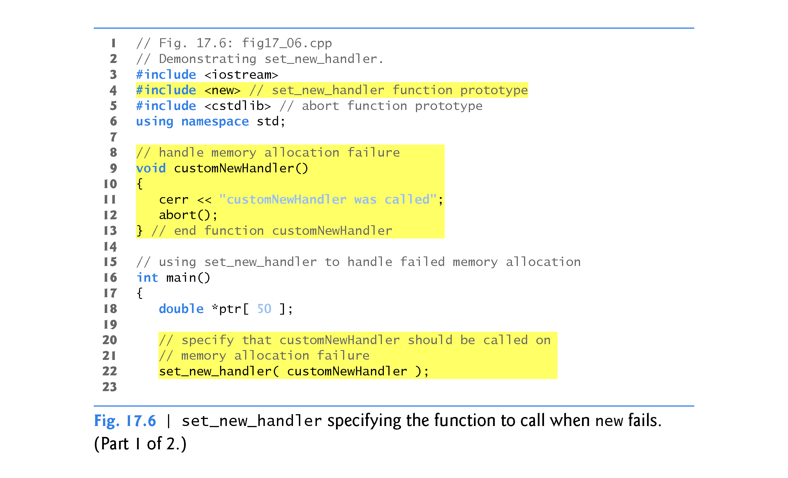

Slide 73
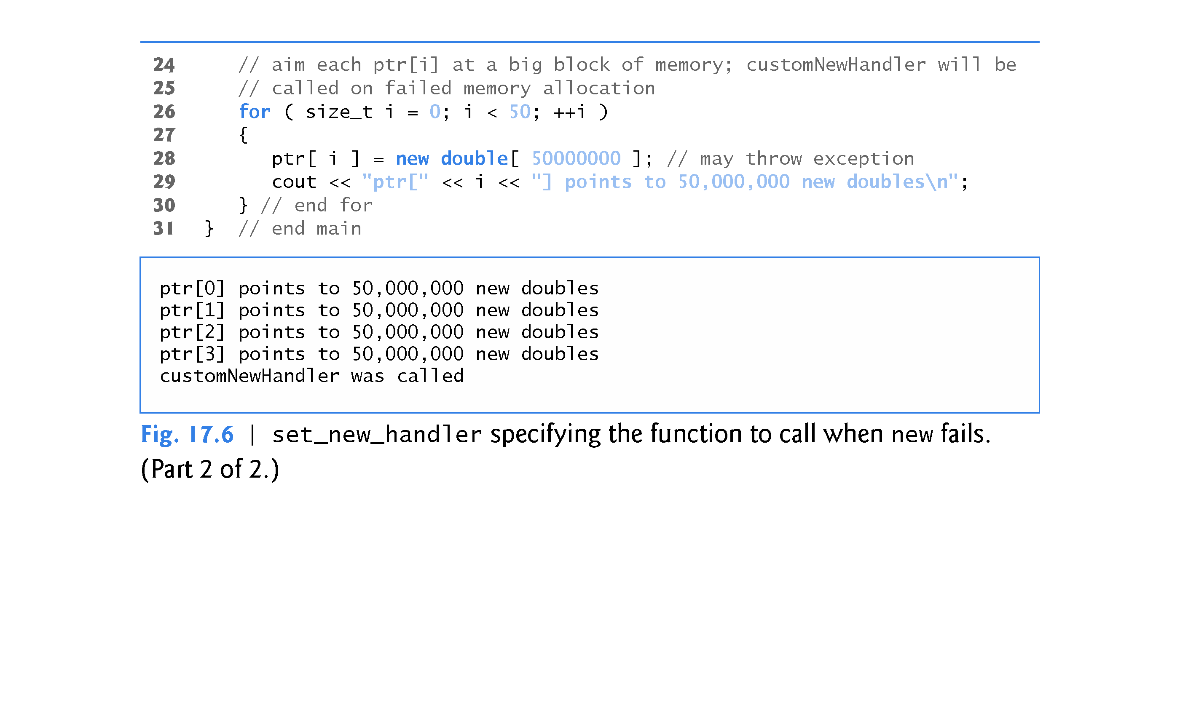

Slide 74
17.9 Class unique_ptr and Dynamic Memory Allocation
A common programming practice is to allocate dynamic memory, assign the address of that memory to a pointer, use the pointer to manipulate the memory and deallocate the memory with delete when the memory is no longer needed.
If an exception occurs after successful memory allocation but before the delete statement executes, a memory leak could occur.
C++ 11 provides class template unique_ptr in header file <memory> to deal with this situation.

Slide 75
17.9 Class unique_ptr and Dynamic Memory Allocation (cont.)
An object of class unique_ptr maintains a pointer to dynamically allocated memory.
When an unique_ptr object destructor is called (for example, when an unique_ptr object goes out of scope), it performs a delete operation on its pointer data member.
Class template unique_ptr provides overloaded operators * and -> so that a unique_ptr object can be used just as a regular pointer variable is.
Figure 17.9 demonstrates a unique_ptr object that points to a dynamically allocated object of class Integer (Figs. 17.7–17.8).

Slide 76
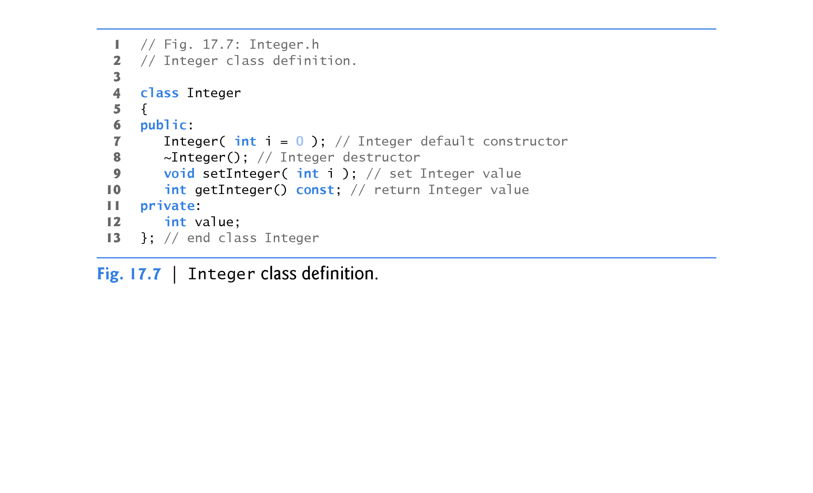

Slide 77
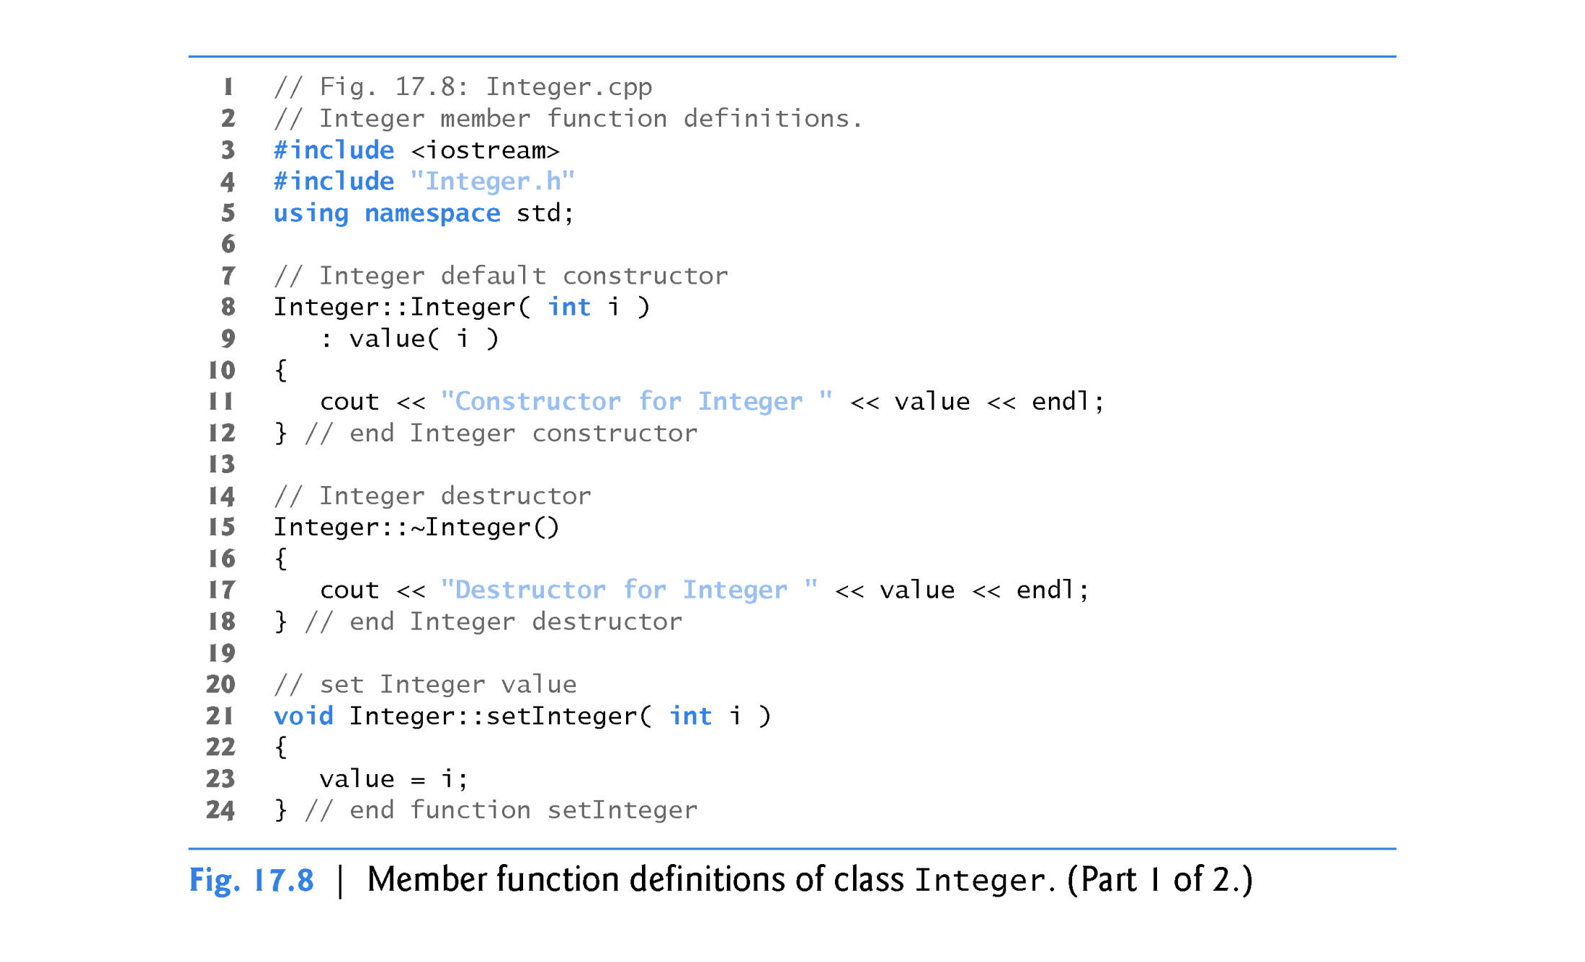

Slide 78
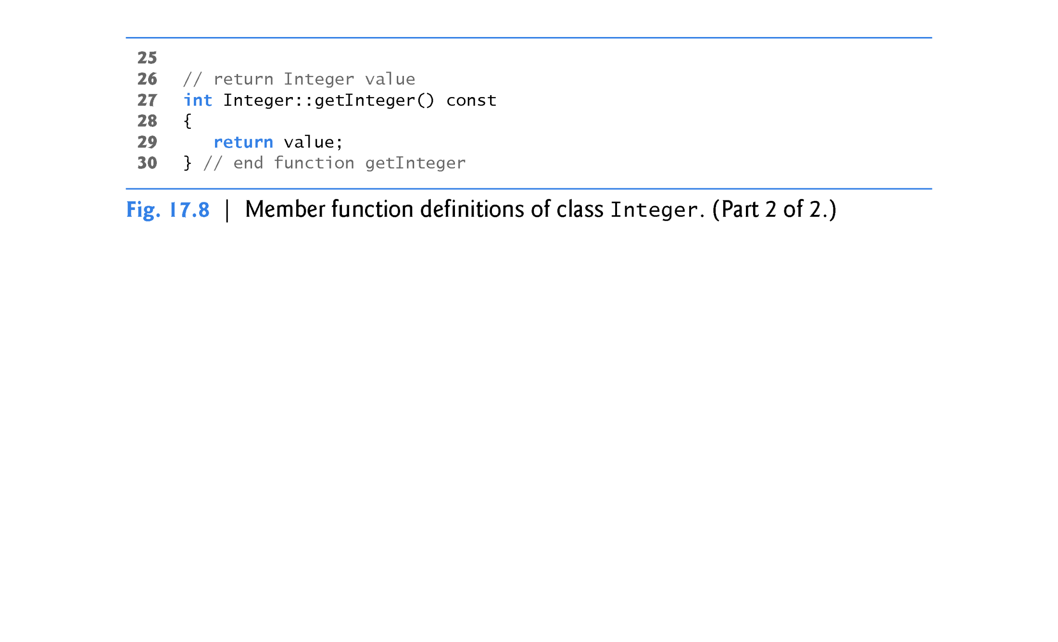

Slide 79
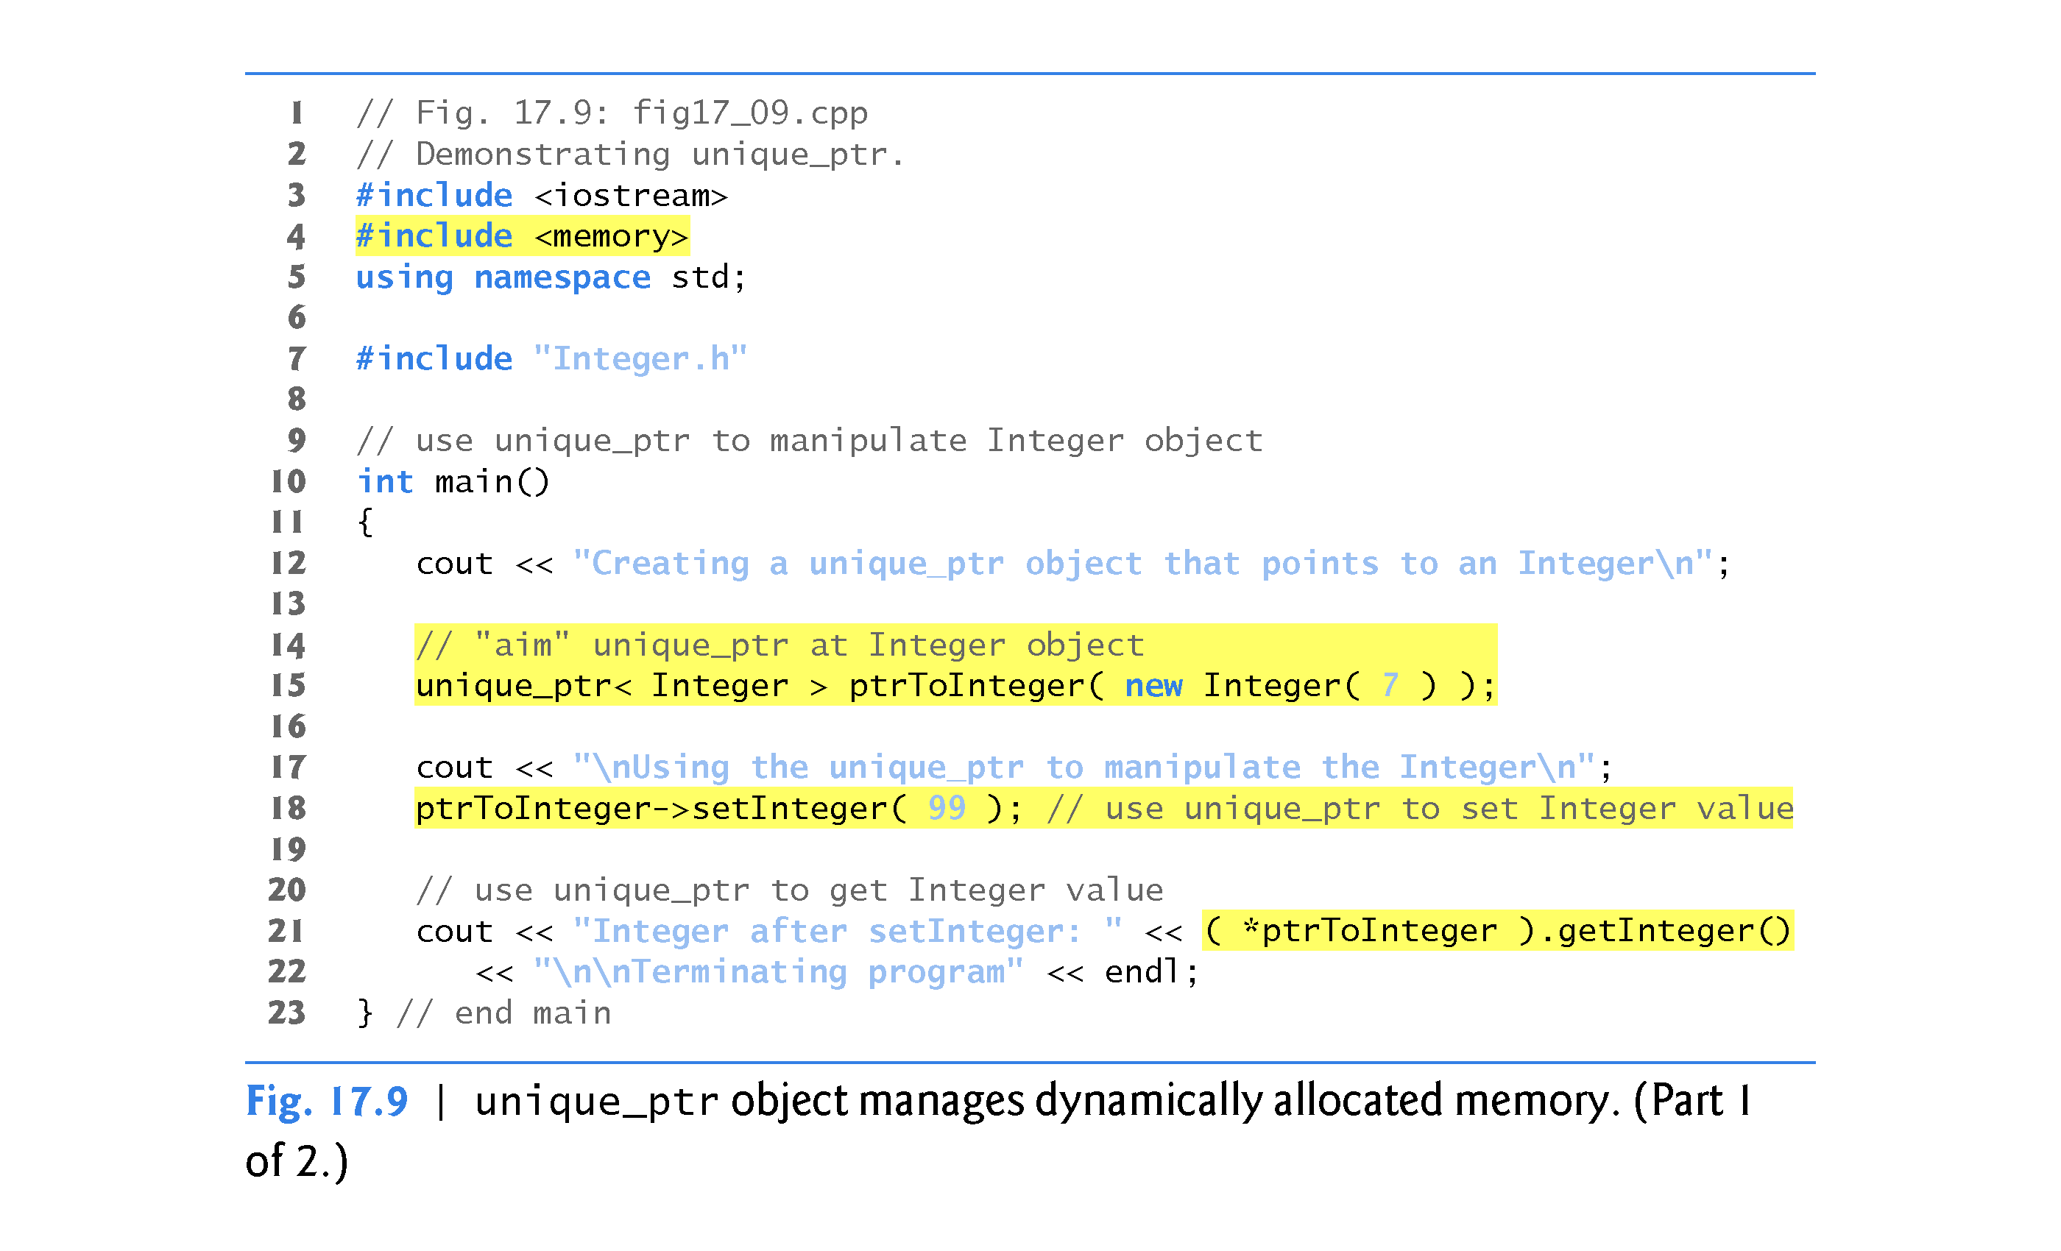

Slide 80
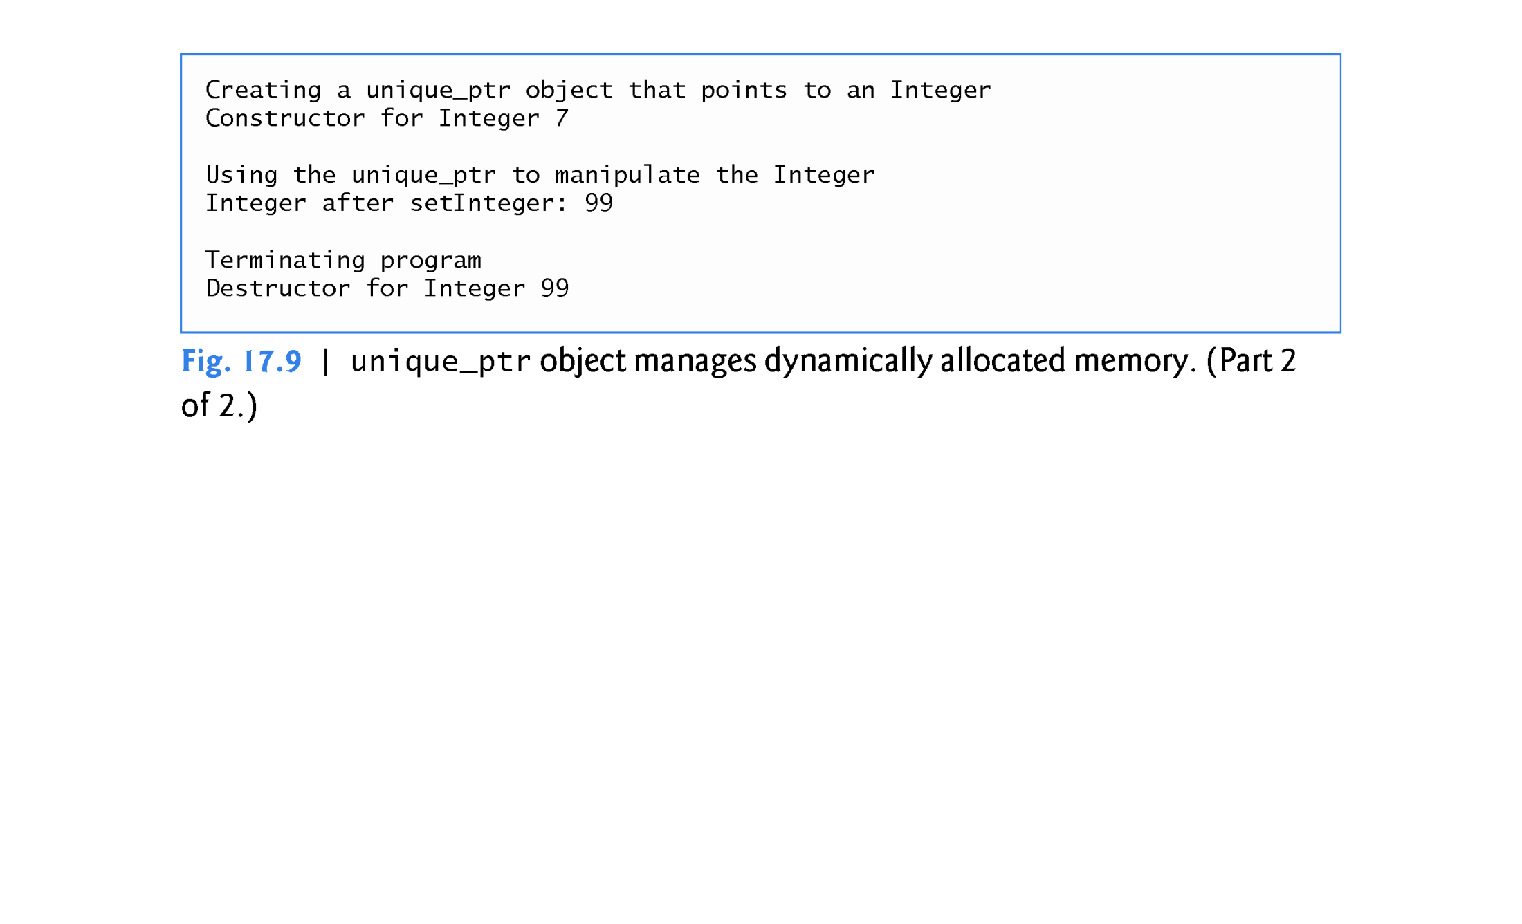

Slide 81
17.9 Class unique_ptr and Dynamic Memory Allocation (cont.)
Because ptrToInteger is a local automatic variable in main, ptrToInteger is destroyed when main terminates.
The unique_ptr destructor forces a delete of the Integer object pointed to by ptrToInteger, which in turn calls the Integer class destructor.
The memory that Integer occupies is released, regardless of how control leaves the block (e.g., by a return statement or by an exception).
Most importantly, using this technique can prevent memory leaks.

Slide 82
17.9 Class unique_ptr and Dynamic Memory Allocation (cont.)
unique_ptr Notes
The class is called unique_ptr because only one unique_ptr at a time can own a dynamically allocated object.
By using its overloaded assignment operator or copy constructor, a unique_ptr can transfer ownership of the dynamic memory it manages.

Slide 83
17.9 Class unique_ptr and Dynamic Memory Allocation (cont.)
The last unique_ptr object that maintains the pointer to the dynamic memory will delete the memory.
This makes unique_ptr an ideal mechanism for returning dynamically allocated memory to client code.
When the unique_ptr goes out of scope in the client code, the unique_ptr’s destructor destroys the dynamically allocated object and deletes its memory.

Slide 84
17.9 Class unique_ptr and Dynamic Memory Allocation (cont.)
unique_ptr to a Built-In Array
You can also use a unique_ptr to manage a dynamically allocated built-in array.
For example, consider the statement
unique_ptr< string[] > ptr( new string[10] );
which dynamically allocates an array of 10 strings managed by ptr.
The type string[ ] indicates that the managed memory is a built-in array containing strings.

Slide 85
17.9 Class unique_ptr and Dynamic Memory Allocation (cont.)
When a unique_ptr that manages an array goes out of scope it deletes the memory with delete [ ] so that every element of the array receives a destructor call.
A unique_ptr that manages an array provides an overloaded [ ] operator for accessing the array’s elements.
For example, the statement
ptr[2] = "hello";
assigns "hello" to the string at ptr[2] and the statement
cout << ptr[2] << endl;
displays that string.

Slide 86
Class unique_ptr Code Examples
Link to ZIP file with examples: unique_ptr Code Examples

Slide 87
17.10 Standard Library Exception Hierarchy
Experience has shown that exceptions fall nicely into a number of categories.
The C++ Standard Library includes a hierarchy of exception classes, some of which are shown in Fig. 17.10.
As we first discussed in Section 17.2, this hierarchy is headed by base-class exception (defined in header file <exception>), which contains virtual function what that derived classes can override to issue appropriate error messages.

Slide 88
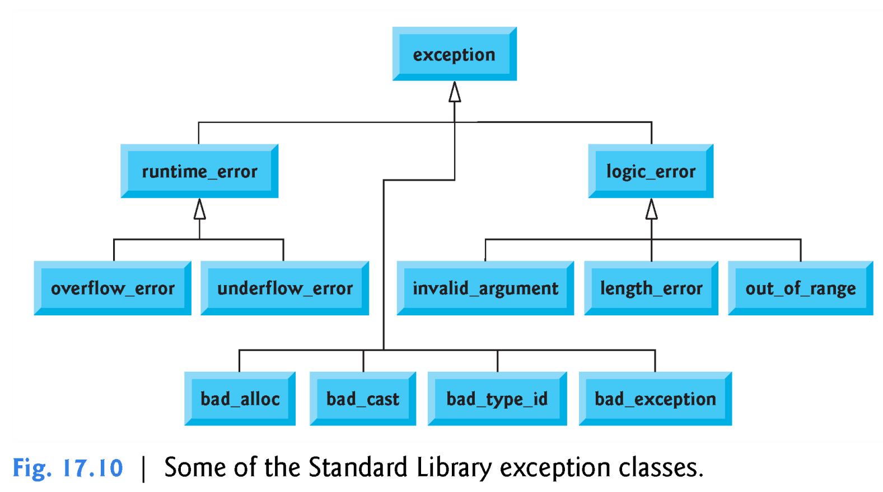

Slide 89
Exception Classes <stdexcept>
logic_error and runtime_error are derived classes of base class exception:
logic_error exception class to indicate violations of logical preconditions or class invariants
invalid_argument exception class to report invalid arguments
domain_error exception class to report domain errors
length_error exception class to report attempts to exceed maximum allowed size
out_of_range exception class to report arguments outside of expected range
runtime_error exception class to indicate conditions only detectable at run time
range_error exception class to report range errors in internal computations
overflow_error exception class to report arithmetic overflows
underflow_error exception class to report arithmetic underflows

Slide 90
17.10 Standard Library Exception Hierarchy (cont.)
Immediate derived classes of base-class exception include runtime_error and logic_error (both defined in header <stdexcept>), each of which has several derived classes.
Also derived from exception are the exceptions thrown by C++ operators:
bad_alloc is thrown by new (Section 17.8),
bad_cast is thrown by dynamic_cast (Chapter 12) and
bad_typeid is thrown by typeid (Chapter 12).

Slide 91
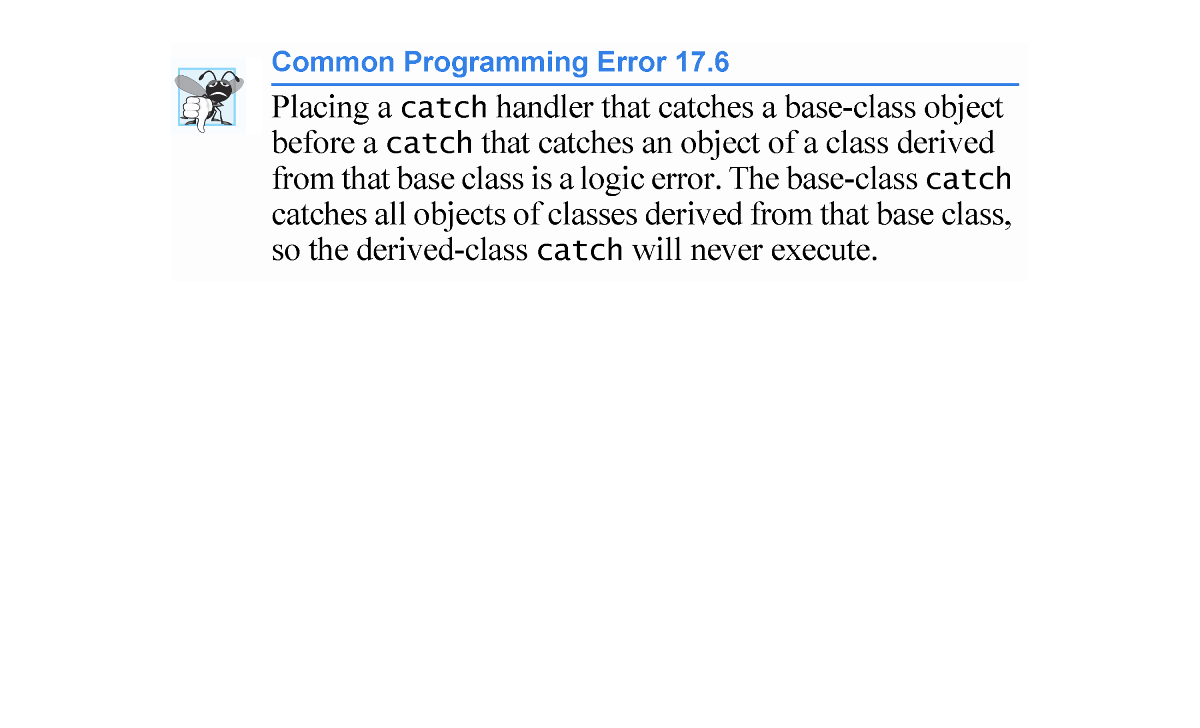

Slide 92
17.10 Standard Library Exception Hierarchy (cont.)
Class logic_error is the base class of several standard exception classes that indicate errors in program logic.
class invalid_argument indicates that a function received an invalid argument.
Proper coding can, of course, prevent invalid arguments from reaching a function.
Class length_error indicates that a length larger than the maximum size allowed for the object being manipulated was used for that object.
Class out_of_range indicates that a value, such as a subscript into an array, exceeded its allowed range of values.

Slide 93
17.10 Standard Library Exception Hierarchy (cont.)
Class runtime_error, which we used briefly in Section 17.4, is the base class of several other standard exception classes that indicate execution-time errors.
class overflow_error describes an arithmetic overflow error (i.e., the result of an arithmetic operation is larger than the largest number that can be stored in the computer)
class underflow_error describes an arithmetic underflow error (i.e., the result of an arithmetic operation is smaller than the smallest number that can be stored in the computer).

Slide 94
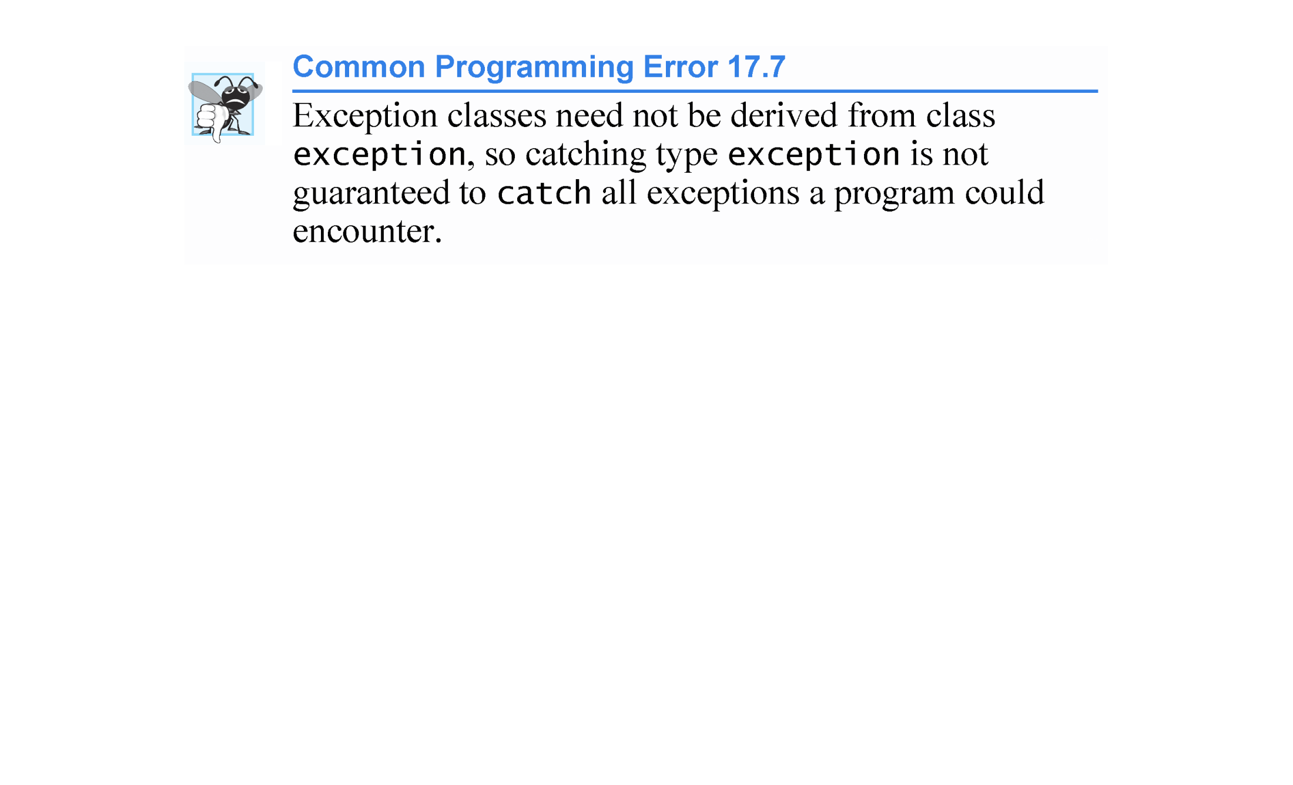

Slide 95
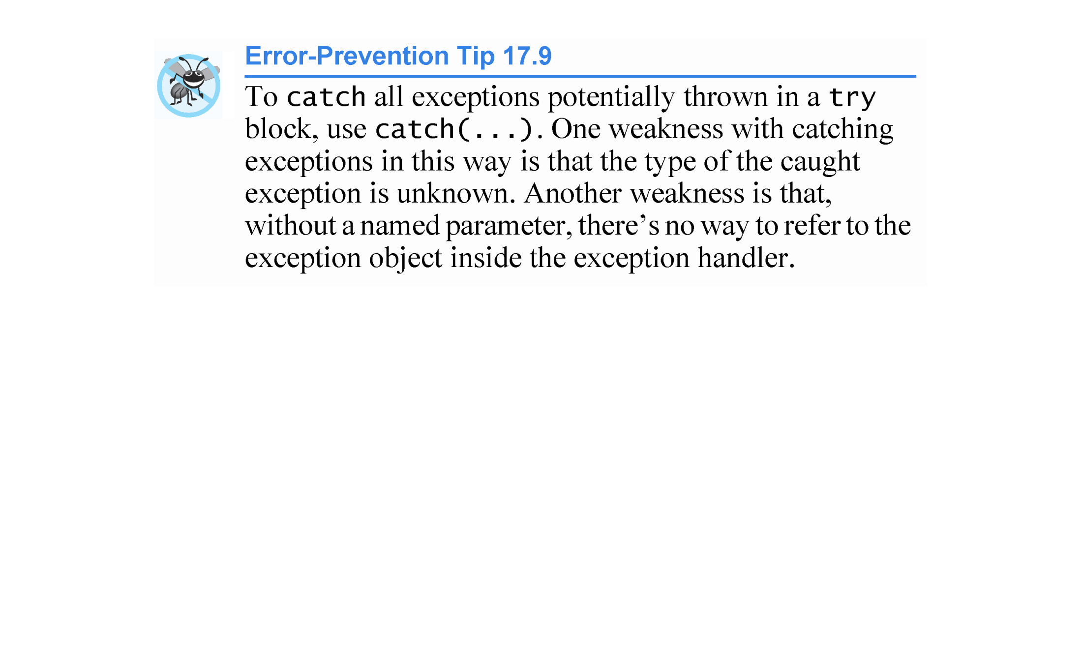

Slide 96
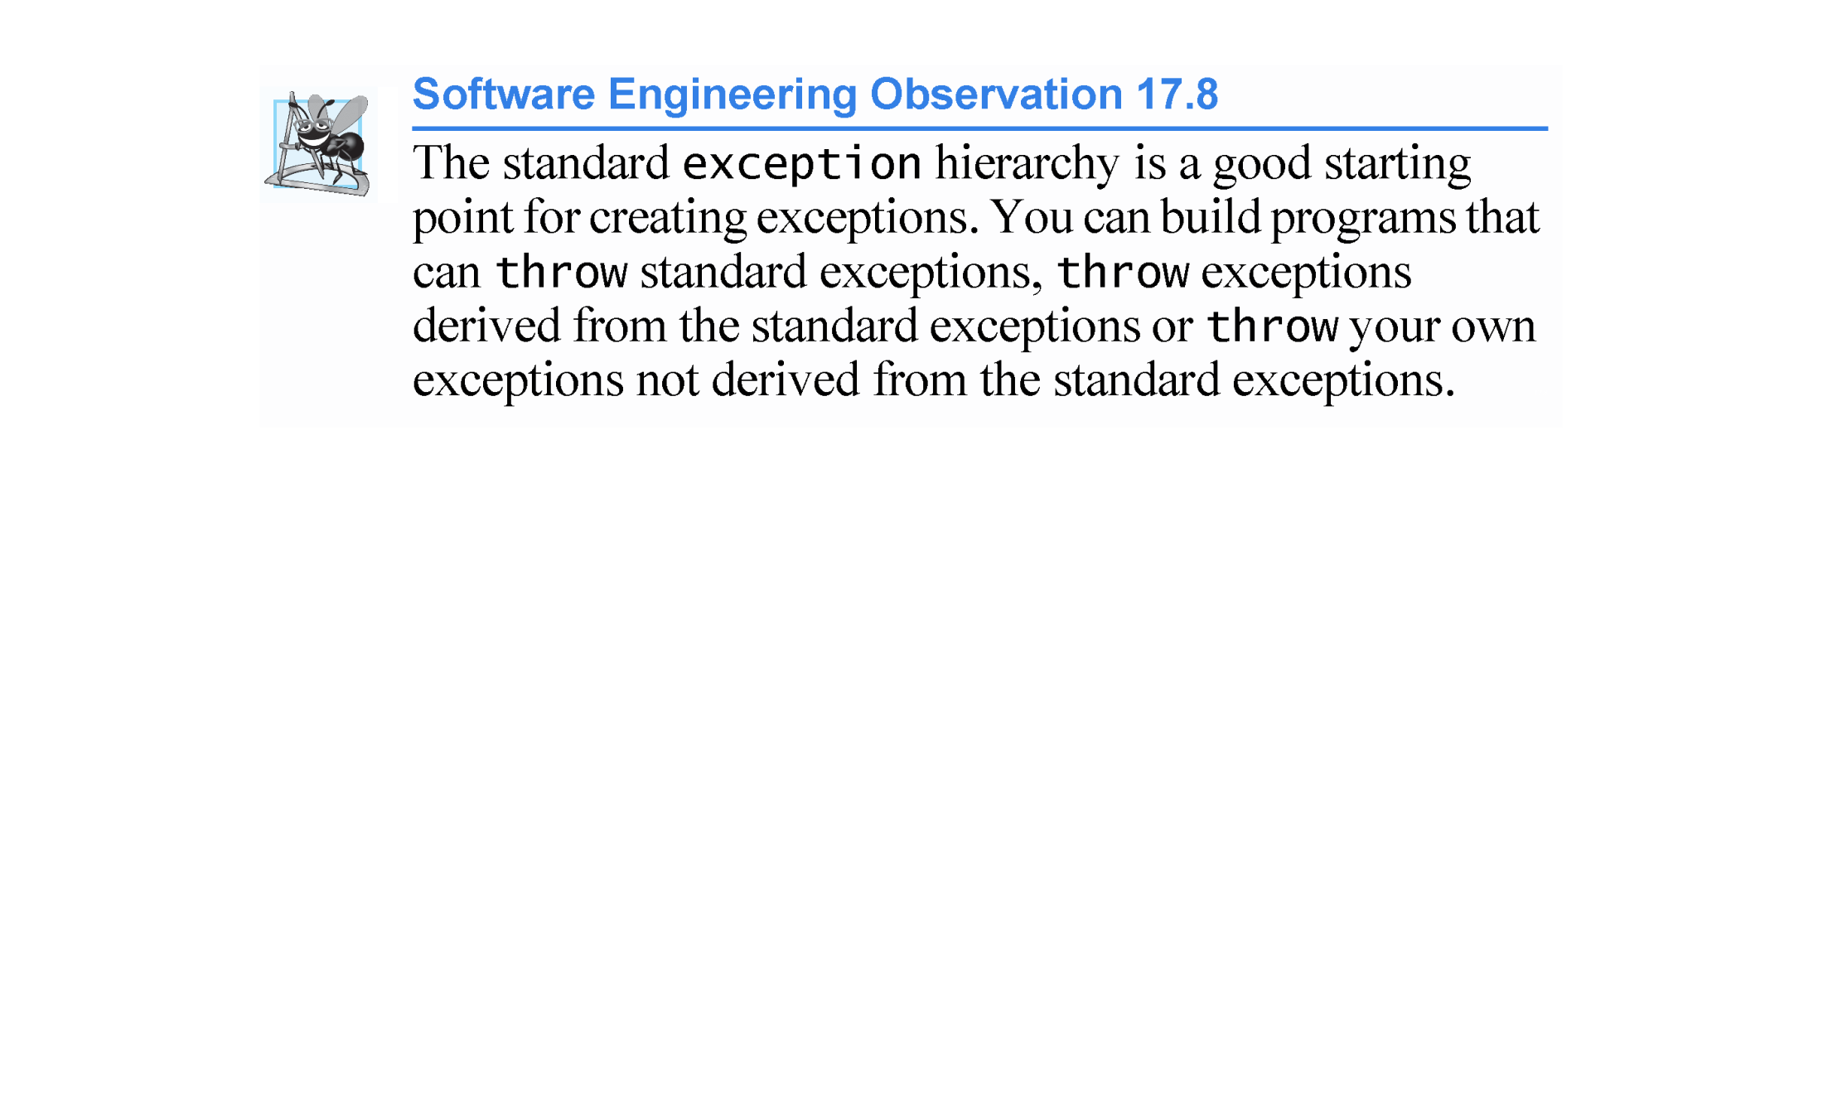

Slide 97
